Slide 1
The Weekly SOCIOLOGY and NEWS HEADLINES for YOU!

Slide 2
Sociology helps YOU understand the social forces that shape individuals and societies so you can use this knowledge to become a better YOU and promote the greater good!

Slide 3
HOW…
is college student out-of-state voting related to the 2020 Presidential election?

Slide 5
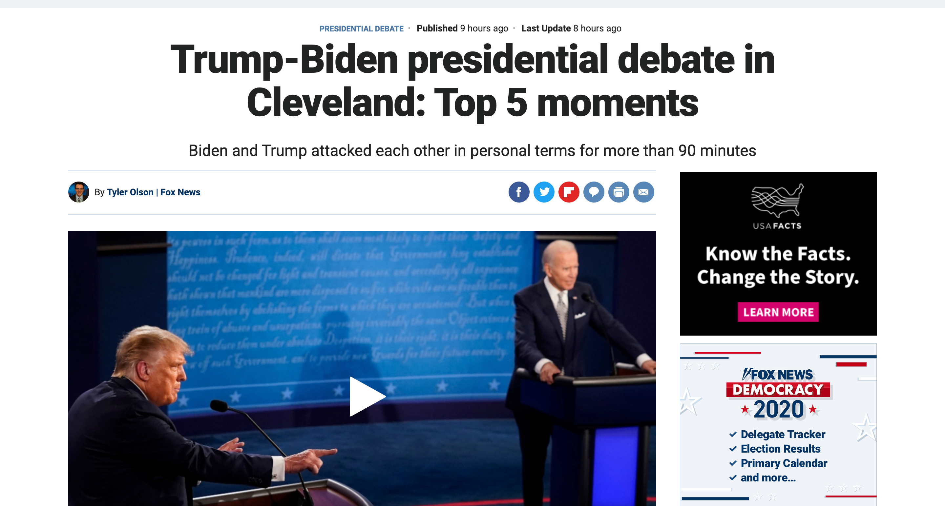

Slide 6
Sociologists study…
concepts such as disenfranchisement, an effort to restrict or revoke the voting rights of an individual or group, as well as issues such as voting fraud. Mail-in ballots has become a key topic in this campaign and was hotly discussed in the first debate.

Slide 7
Discussion Are there challenges to overcome in regard to out-of-state college students voting in the presidential election?

Slide 8
Discussion How do presidential elections impact social structures in the U.S.?

Slide 9
This resource provided by the co-authors of SociologicalYOU to help students… “Connect Sociology and YOU!” Contact us at Support@SociologicalYOU.com to learn more about the “One-Hour Adoption” process and to request a 10-minute Zoom demo.

