Slide 1


SociologicalYOU
Angela Thompson, Ph.D.
Keith Whitworth, Ph.D.
Introductory Sociology

Slide 2
Chapter 1
Introduction: Understanding Sociology

Slide 3
The Five Modules in SociologicalYOU
Module 1: Sociological Perspective
  The process of understanding and explaining how individuals and groups interact within society.
Module 2: Social Structures
  The distinctive and stable arrangements of social patterns that form the society as a whole.
Module 3: Social Problems
  The societal-level conditions that harm segments of society.

Slide 4
The Five Modules in SociologicalYOU
Module 4: Sociological Imagination
  The ability to see the details of our own lives in the context of larger social structures as opposed to merely personal choices or personal troubles.
Module 5: Social Change
  The social forces that change the organization and social structures of society.
This PowerPoint does not cover every key term in Chapter 1.
Please read your textbook to see what is not covered in the PowerPoint.

Slide 5


Points to Ponder
What is sociology and how was it developed?
What are the basic theories and vocabulary within sociology?
How is sociology relevant to your life?

Slide 6
Module 1: Sociological Perspective
Sociology: In the Beginning
L.O. 1.1.1: Compare Comte’s means of studying society with the methods of studying natural science
Society: a large group of people associated with a shared culture and social institutions.
Social Institutions: structures in society providing the framework for governing the behavior of individuals in a community or society.

Slide 7
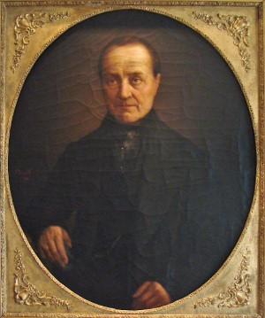
Module 1: Sociological Perspective
Sociology: In the Beginning
L.O. 1.1.1: Compare Comte’s means of studying society with the methods
of studying natural science
Auguste Comte (1798-1857)
Father of sociology
Positivism: authentic and valid knowledge of the social world found only through scientific and empirical pursuit.
Sociology: the scientific study of social relationships, social institutions, and societies.

Slide 8
Module 1: Sociological Perspective
Sociological Theory: The Basics
L.O. 1.1.2: Compare and contrast the three sociological theories or views of society.
Sociological theory: a set of interrelated ideas that provide a systematic understanding of the social world.
Macro Sociology: a level of analysis focusing on social systems and populations on a large scale.
Micro Sociology: a level of analysis focusing on individuals and small groups within the larger social system.

Slide 9
Module 1: Sociological Perspective
Sociological Theory: The Basics
L.O. 1.1.2: Compare and contrast the three sociological theories or views of society.
Theories | Level of Analysis
Conflict | Macro
Functionalist | Macro
Symbolic Interaction | Micro

Slide 10
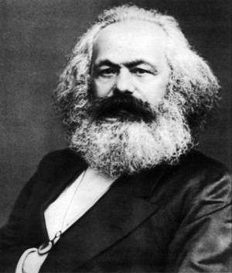
Module 1: Sociological Perspective
Sociological Theory: The Basics
L.O. 1.1.2: Compare and contrast the three sociological
theories or views of society.
Karl Marx (1818–1883)
Conflict Theory: a macro theory based on class struggles and exploitation.
    Proletariat: the majority, who were the poor, property-less industrial working class.
    Bourgeois: the small minority who were the wealthy class.

Slide 11
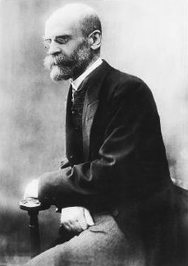
Module 1: Sociological Perspective
Sociological Theory: The Basics
L.O. 1.1.2: Compare and contrast the three sociological
theories or views of society.
Émile Durkheim (1858-1917)
Functionalist Theory: a macro view of how the parts of society serve to maintain stability.
    Manifest Functions: intentional and formally sanctioned functions of social institutions and society.
    Latent Functions: unintentional and informally sanctioned functions of social institutions and society.
    Dysfunction: the undesirable disruptions of social patterns resulting in negative consequences within society.

Slide 12
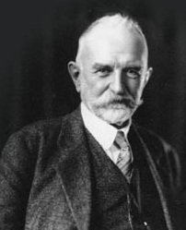
Module 1: Sociological Perspective
Sociological Theory: The Basics
L.O. 1.1.2: Compare and contrast the three sociological
theories or views of society.
George Herbert Mead (1863-1931)
Symbolic Interactionism: a micro view of how society is the product of interactions between people, which occur via symbols that have distinct meanings.
Socialized Self: the self cannot develop apart from society.

Slide 13
Table 1.1.1: Sociological Theories: Application
Health Care Conflict Theory | Health Care Functionalist Theory | Health Care Symbolic Interactionist Theory
Millions of working poor Americans do not have access to health care due to the cost. The U.S. is the only industrialized nation that does not provide health care for all citizens. This causes the gap between the poor and the rich to grow wider as families go into debt to pay for medical bills. | Hospitals, medical professionals, and pharmaceutical companies serve to keep individuals healthy so all can work and earn wages to keep society functioning. If illnesses and diseases are frequent and workers cannot work, then the economy will suffer. | The meaning of the doctor-patient relationship helps to understand the health care delivery system. The doctor’s lab coat and specialized knowledge and language symbolize authority and thus the patient is more likely to be compliant and passive in the treatment process.
Link to alternative text for this content

Slide 14
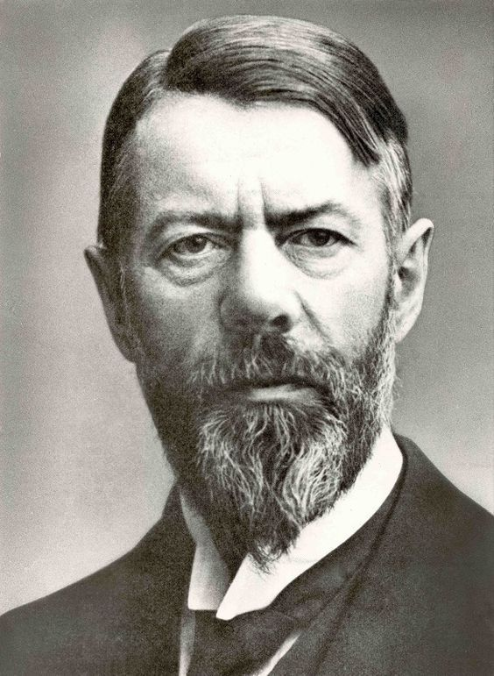
Module 1: Sociological Perspective
Weber: A Different Perspective
L.O. 1.1.4: Define verstehen and compare and contrast how Weber’s
perspective differs from the three main sociological theories.
Max Weber (1864-1920)
Verstehen: an empathetic approach to understanding human behavior.

Slide 15
Module 1: Sociological Perspective
Contemporary Theories: New Approaches
L.O. 1.1.5: Summarize the feminist, queer, and postmodern theories.
Feminist Theory: a view pertaining to anti-oppression, gender relations, and gender inequality.
Applied Sociology: the use of sociological theory, research, and methodologies to find solutions to problems in society.
Queer Theory: a critical view that rejects the traditional categories of gender, sex, and sexuality in contemporary society.
Postmodern Social Theory: a critical view rejecting the historical, scientific, and structured means of investigating and interpreting the social world.

Slide 16
Module 2: Social Structures
Unfolding Characteristics of Social Structures
L.O. 1.2.1: Explain characteristics of social structures.
Social Structures: the distinctive and stable arrangements of social patterns that form the society as a whole.
    Organizes behaviors of large groups of people
    Capable of coercing individuals and groups
    Provides norms, rules, and practices
    Assigns roles and powers to individuals and groups
    Encompasses large geographical areas

Slide 17
Module 2: Social Structures
Practicing Sociologists during Times of Change
L.O. 1.2.2: Describe how Martineau, Addams, Du Bois, and Merton recognized social structures in their research, writings, or practice of sociology.
Harriet Martineau (1802-1876)
First female sociologist
Society in America (1837)
Gender, racial, and class tensions
“Outsider’s” look at the American culture

Slide 18
Module 2: Social Structures
Practicing Sociologists during Times of Change
L.O. 1.2.2: Describe how Martineau, Addams, Du Bois, and Merton recognized social structures in their research, writings, or practice of sociology.
Jane Addams (1860-1935)
Poverty and education
Hull House (1889)

Slide 19
Module 2: Social Structures
Practicing Sociologists during Times of Change
L.O. 1.2.2: Describe how Martineau, Addams, Du Bois, and Merton recognized social structures in their research, writings, or practice of sociology.
W. E. B. Du Bois (1868-1963)
National Association for the Advancement of Colored People (NAACP)
The Talented Tenth
Racism and discrimination

Slide 20
Module 2: Social Structures
Practicing Sociologists during Times of Change
L.O. 1.2.2: Describe how Martineau, Addams, Du Bois, and Merton recognized social structures in their research, writings, or practice of sociology.
Robert Merton (1910-2003)
Social Theory and Social Structure
Bureaucracy: a hierarchical authority structure that uses task specialization, operates on the merit principle, and behaves with impersonality.
Red Tape: adherence to excessive regulation and conformity that prevents decision-making and change.

Slide 21
Module 2: Social Structures
Social Structures: Real Life Applications
L.O. 1.2.3: Identify social structures within a contemporary social issue.
How do social structures impact us today?
College Campus
Binge Drinking
Sexual Assaults

Slide 22
Module 3: Social Problems
The Human Side of Our Sweet Addiction
L.O. 1.3.1: Identify the role of sociology in understanding social problems.
Social Problems: the societal caused conditions that harm segments of society.
Objective Conditions: the scope of a problem.
Subjective Concerns: people’s feelings about a problem.

Slide 23
Module 3: Social Problems
The Human Side of Our Sweet Addiction
L.O. 1.3.1: Identify the role of sociology in understanding social problems.
Fair Trade: an organizational movement and certification process to help producers in developing countries receive a fair price for their products with the goals of reducing poverty, providing for the ethical treatment of workers and farmers, and promoting environmentally sustainable practices.
Sustainability: the idea that current and future generations should have equal or greater access to social, economic, and environmental resources.
Sustainable Development: development that meets the needs of the present without compromising the ability of future generations to meet their own needs.

Slide 24

Module 3: Social Problems
Social Inequality: Poor Families Aren’t Allowed a Dad
L.O. 1.3.2: Describe the social problems associated with a social inequality.
Social Inequality: the unequal distribution of power, property or prestige in society.
    Homelessness
    Healthcare
    Teen pregnancy
    Education
    Life expectancy

Slide 25
Module 4: The Sociological Imagination
United We Stand, Divided We Fall: The Importance of Social Bonds
L.O. 1.4.1: Explain the relationship between the sociological imagination and Durkheim’s anomie.
Sociological Imagination: means of understanding the relationship between our personal troubles and the public issues of society.
Personal Troubles: matters experienced at the individual level.
Public Issue: matters that impact society as a whole.
Anomie: breakdown of individual and community social bonds.

Slide 26
Module 5: Social Change
It’s a Small World After All
L.O. 1.5.1: Evaluate the consequence of globalization in the context of social change.
Social Change: the forces that change the organization and the social structures of society.
Globalization: the worldwide integration of our cultural, economic, and political lives that result from ever-increasing levels of business, trade, and technology.

Slide 27


Globalization: China’s Old and New Silk Roads

Slide 28
Module 5: Social Change
Sociology on the Job
L.O. 1.5.2: Explain how sociology can be applied to social change.
Applied Sociology: the use of sociological theory, research, and methodologies to find solutions to problems in society.

Slide 30
Accessibility Content:
Text Alternatives for Images

Slide 31
Sociological Theories – Text Alternative
Application of sociological theories to the health care system.
Conflict theorists’ perspective of health care: Millions of working poor Americans do not have access to health care due to the cost. The U.S. is the only industrialized nation that does not provide health care for all citizens. This causes the gap between the poor and the rich to grow wider as families go into debt to pay for medical bills.
Functionalists’ perspective of health care: Hospitals, medical professionals, and pharmaceutical companies serve to keep individuals healthy so all can work and earn wages to keep society functioning. If illnesses and diseases are frequent and workers cannot work, the the economy will suffer.
Symbolic interactionists’ perspective of health care: The meaning of the doctor-patient relationship helps to understand the health care delivery system. The doctor’s lab coat and specialized knowledge and language symbolize authority and thus the patient is more likely to be compliant and passive in the treatment process.
Return to slide containing original content
United Instructors & Textbook Authors Co-op - SociologicalYOU - ISBN 978-1-64007-406-4 - All Rights Reserved

