Slide 1
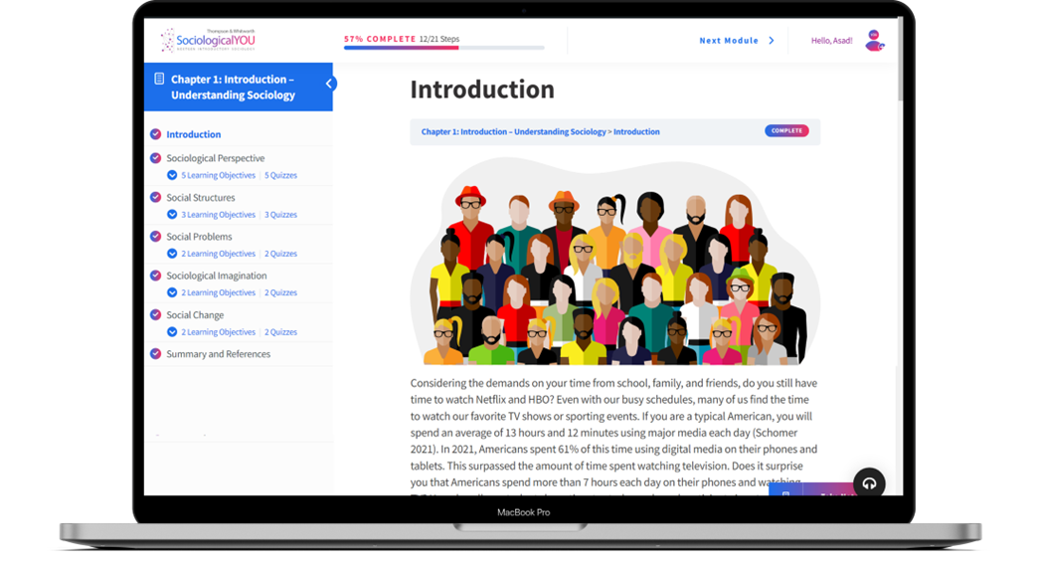

SociologicalYOU
Angela Thompson, Ph.D.
Keith Whitworth, Ph.D.
Introductory Sociology

Slide 2
Chapter 11
Economics and Politics: Money and Power

Slide 3
Modules
Module 1: The Intersection of Economics and Politics
Module 2: Social Characteristics of Economics and Politics
Module 3: Social Problems in Politics
Module 4: Sociological Imagination and the Economy
Module 5: Political Process and Change
This PowerPoint does not cover every key term in Chapter 11.
Please read your textbook to see what is not covered in the PowerPoint.

Slide 4


Points to Ponder
How are economics and politics intertwined?
What are key characteristics to predict your political engagement?
What social problems are associated with the political system?

Slide 5
Module 1: The Intersection of Economics and Politics
The Economics of Political Participation
L.O. 11.1.1: Analyze the intersection of economics and politics as it relates to political participation.
Political Sociology: the study of political groups, leadership, and power within society.
Political Participation: actions to support government or politicians.
Civic Participation: individual and collective action to address issues of public concern.
Political Consumerism: choosing producers and products with the goal of changing ethical or objectionable institutional or market practices.

Slide 6
Module 1: The Intersection of Economics and Politics
Women and Politics
L.O. 11.1.2: Examine the political lives of women in the U.S.
Political Socialization
Begins in the family and continues through school and into the workforce.
Long-term impact on political views and participation.

Slide 7
Module 1: The Intersection of Economics and Politics
Economics, Politics, and Climate Change
L.O. 11.1.3: Explain how politics and economics are related to climate change.
Global Warming: the rise in surface temperature on the planet.
Climate Change: the weather impacts of the rising temperatures.

Slide 8
Module 2: Structural Characteristics of Economics and Politics
Past and Present Economic Systems
L.O. 11.2.1: Explain economic and political systems.
Past and Present Types of Societies
Hunting and Gathering
Horticultural and Pastoral
Agricultural
Industrial
Post Industrial or Information Age

Slide 9
Module 2: Structural Characteristics of Economics and Politics
Past and Present Economic Systems
L.O. 11.2.1: Explain economic and political systems.
Economic Systems: a framework for the production and allocation of goods and services within a society.
Capitalism: an economic and political system based on private control of the production and distribution of goods and services within a free market system.
Laissez-Faire Capitalism: a system of free enterprise without government intervention.
Monopolies: possessing near or complete control of commodities or production of goods and services.
Socialism: an economic and political system based on the cooperative management of the production and distribution of goods and services by citizens within a democratic government.
Communism: an economic and political system based on the ownership and regulation of all of the production and distribution of goods and services by the government.
Totalitarian: a state-controlled government holding all authority over public and private lives.

Slide 10
Module 2: Structural Characteristics of Economics and Politics
Past and Present Economic Systems
L.O. 11.2.1: Explain economic and political systems.
Governing Systems
Democracy: a system of government in which the power is vested in the people and free elections are held.
Absolute Monarchy: a system of government ruled by a monarch who has control of the government and state.
Constitutional Monarchy: a system of government in which a monarch is the Head of State and governed by a parliament.

Slide 11
Module 2: Structural Characteristics of Economics and Politics
Models of Power
L.O. 11.2.2: Describe the three models of power within governments.
Power: the ability to exert control over others and achieve goals with or without the support of society.
Marxist Power Model: ruling forces formulate public policies that are in the best interest of capitalism and the ruling class.
Power Elite Model: power is concentrated among the elite and wealthy, particularly corporations, government, and the military.
Pluralist Power Model: power is fragmented and dispersed among groups within a society.

Slide 12
Module 2: Structural Characteristics of Economics and Politics
Political Systems
L.O. 11.2.3: Describe how lobbying is a structural component within the political and economic systems.
Lobbyist: individuals who persuade legislators to vote for the special interest of their group.
  Disseminate information to legislators to assist in legislation.
  Identify public opinions about issues important to clients.
  Influence political agenda by creating coalitions to support or oppose bills.

Slide 13

Module 3: Social Problems in Politics
Redistricting
L.O. 11.3.1: Analyze the role of redistricting in the political process.
Redistricting: changes in the boundaries of an electoral voting district.
Proportional representation: a system in which a political party’s representation in government is proportional to the number of votes they receive.

Slide 14
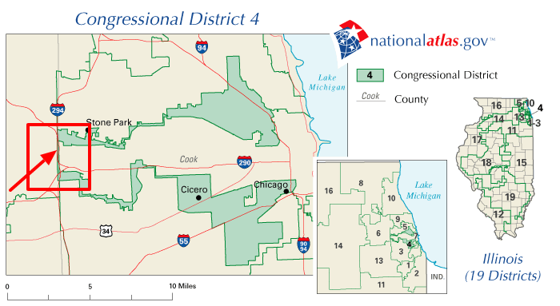
Figure 11.3.1: Illinois Congressional District 4
Link to alternative text for this content

Slide 15
Module 3: Social Problems in Politics
Early Voting Restrictions
L.O. 11.3.2: Summarize the issues associated with early voting restrictions.
Early Voting Restrictions
Shortens the number of days early voters can cast their ballot.
Eliminates the same-day registration and voting option.
Restricts early voting to weekdays and prohibits evening voting.
Allows voting only in election offices and not neighborhood polling stations.
Adds early voting to white suburbs while simultaneously cutting it in minority inner cities.

Slide 16
Module 3: Social Problems in Politics
College Student Voters
L.O. 11.3.3: Explain the recent changes to the college student voter experience.
What groups are often most impacted by disenfranchisement?
Disenfranchisement: an effort to restrict or revoke the voting rights of an individual or group.

Slide 17
Module 3: Social Problems in Politics
Voter Identification Laws
L.O. 11.3.4: Evaluate the impact of voter identification laws.
Poll Tax: a fee members of the electorate must pay in order to participate in the voting process.

Slide 18
Module 4: Sociological Imagination and the Economy
Outsourcing and Offshoring
L.O. 11.4.1: Analyzing the public nature of job loss.
Outsourcing: hiring a subcontractor or outside agency to complete the work formally done by employees within a company.
Offshoring: corporations transferring jobs overseas.
Sweatshops: factories that offer their workers low wages and long hours in dangerous working conditions.
Knowledge Workers: employees whose job involves designing, preparing, or sharing knowledge.
Service Worker: employees whose job it is to provide food, physical comfort, shelter, or mechanical support.
Downsizing: a reduction in the number of employees that work for the corporation.

Slide 19
Table 11.4.1: Outsourcing vs. Offshoring
 | Outsourcing | Offshoring
Pros | Reduced cost for the company A more flexible labor force Increased access to skilled employees | Reduced cost for the company Access to a global labor force Increased access to skilled employees
Cons | Reliance on employees outside the business A disconnect between the company and subcontracted employees Lacking understanding of business processes by subcontracted employees Concerns over product quality control | Language and communication barriers Time differences Unstable geographic and political situations. Concerns over product quality control Added transportation costs for manufactured goods.
Link to alternative text for this content

Slide 20
Module 4: Sociological Imagination and the Economy
The Personal Side of Unemployment
L.O. 11.4.2: Analyze the private nature of job loss.
How can unemployment be both a personal trouble and a public issue?
The personal economic troubles that people experience do not occur in a vacuum.
If there are enough people in society that experience similar challenges, then personal troubles become a public issue.
The intersection between public and private often culminates in the political arena.

Slide 21
Module 5: The Political Process and Change
Buying the Election
L.O. 11.5.1: Evaluate the role of money in the political process.
Fair Elections Now Act
Free Elections
Clean Elections

Slide 23
Accessibility Content: Text Alternatives for Images

Slide 24
Illinois Congressional District 4 – Text Alternative
Map showing Congressional District 4 in Illinois as an example of the role and process behind redistricting.
Return to slide containing original content
United Instructors & Textbook Authors Co-op - SociologicalYOU - ISBN 978-1-64007-406-4 - All Rights Reserved

Slide 25
Outsourcing vs. Offshoring – Text Alternative
Outsourcing
Pros: Reduced cost for the economy, a more flexible labor force, and increased access to skilled employees.
Cons: Reliance on employees outside the business, a disconnect between the company and subcontracted employees, lacking understanding of business processes by subcontracted employees, and concerns over product quality and control.
Offshoring
Pros: Reduced cost for the company, access to global labor force, and increased access to skilled employees.
Cons: Language and communication barriers, time differences, unstable geographic and political situations, concerns over product quality control, and added transportation costs for manufactured goods.
Return to slide containing original content
United Instructors & Textbook Authors Co-op - SociologicalYOU - ISBN 978-1-64007-406-4 - All Rights Reserved

