Slide 1
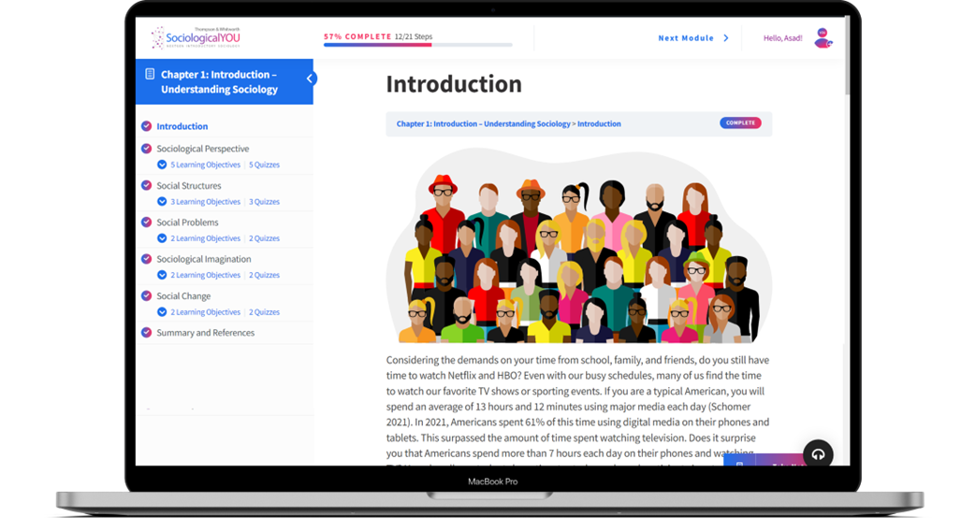

SociologicalYOU
Angela Thompson, Ph.D.
Keith Whitworth, Ph.D.
Introductory Sociology

Slide 2
Chapter 12
Religion and Education: An Educated Belief System

Slide 3
Modules
Module 1: Understanding Religious Beliefs and Practices
Module 2: The Structural Foundation of Religion
Module 3: The American Educational System
Module 4: Education and the Sociological Imagination
Module 5: Changes in the Educational Landscape
This PowerPoint does not cover every key term in Chapter 12.
Please read your textbook to see what is not covered in the PowerPoint.

Slide 4


Points to Ponder
How is religion socially constructed and defined?
How are religion and education intertwined?
How is the educational system changing in the U.S.?

Slide 5
Module 1: Understanding Religious Beliefs and Practices
Defining Religion
L.O. 12.1.1: Define religion from a sociological perspective.
Monotheistic: the belief or worship of a single god.
Polytheistic: the belief or worship of more than one god.

Slide 6
Module 1: Understanding Religious Beliefs and Practices
Defining Religion
L.O. 12.1.1: Define religion from a sociological perspective.
Durkheim’s Definition of Religion “A religion is a unified system of beliefs and practices relative to sacred things…which unite into one single moral community called a Church…”
Marx’s Definition of Religion “Religion is the sigh of the oppressed creature, the heart of a heartless world, and the soul of soulless conditions. It is the opium of the people.”
Berger’s Definition of Religion “The audacious attempt to conceive the entire universe as humanly significant.”
Whitworth’s Definition of Religion “A socially constructed and culturally specific set of beliefs and practices related to defining the meaning of our existence.”

Slide 7

Module 1: Understanding Religious Beliefs and Practices
Individual Religious Beliefs and Practices
L.O. 12.1.2: Describe trends in individuals’ religious beliefs and practices.
Religiosity: the beliefs and behaviors associated with transcendent or spiritual concerns.
Megachurch: a Protestant church with an average of 2,000 or more people in weekly attendance.

Slide 8
Module 1: Understanding Religious Beliefs and Practices
Individual Religious Beliefs and Practices
L.O. 12.1.2: Describe trends in individuals’ religious beliefs and practices.
The 3 B’s of Religion
Beliefs
Behaviors
Belonging

Slide 9
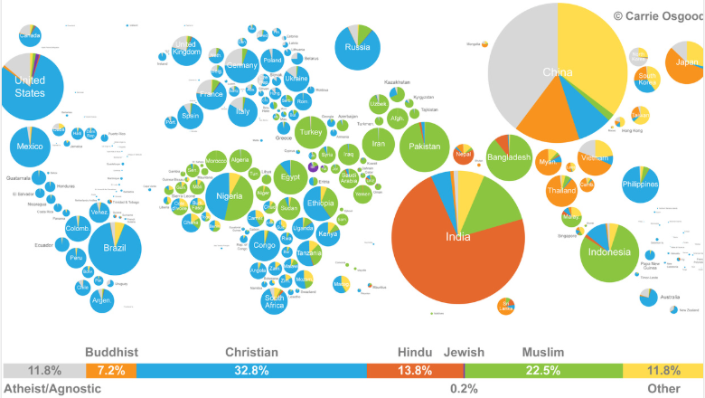
Figure 12.1.1: World Religions
Link to alternative text for this content

Slide 10
Module 1: Understanding Religious Beliefs and Practices
Group Religious Beliefs and Practices
L.O. 12.1.3: Discuss religious beliefs and practices among Muslims.
Fundamentalism: a strict adherence to conservative religious ideology.
Sharia: the revealed word of God based on the Qur’an serving as the body of Islamic law.

Slide 11
Module 1: Understanding Religious Beliefs and Practices
Personal Religious Beliefs and Practices
L.O. 12.1.4: Apply your knowledge of sociology to your personal religious beliefs and practices.
Primary Agents of Socialization (impacting religious preference)
National Religiosity
Family
Peers
School

Slide 12

Module 1: Understanding Religious Beliefs and Practices
Personal Religious Beliefs and Practices
L.O. 12.1.4: Apply your knowledge of sociology to your personal religious beliefs and practices.
Denominations: a distinct group of churches with a common doctrine and name.

Slide 13
Module 2: The Structural Foundation of Religion
The Functions of Religion
L.O. 12.2.1: Discuss the societal functions of religion.
Sacred: things set apart and requiring special religious treatment.
Profane: ordinary and familiar realm of everyday existence.
Social Cohesion: bonds between members that maintain stability in society.
Social Control: the informal and formal regulation of members of society to gain conformity and compliance.

Slide 14
Module 2: The Structural Foundation of Religion
The Functions of Religion
L.O. 12.2.1: Discuss the societal functions of religion.
Functions of Every Religion
Religion provides comfort and quells dissatisfaction.
Religion builds and strengthens communities of people.
Religion assures its followers that there is a larger cosmic order.

Slide 15
Module 2: The Structural Foundation of Religion
Religion, Gender, and Sexuality
L.O. 12.2.3: Examine the structural elements of religion in relation to gender and sexuality.
Patriarchy: lines of descent trace through the paternal side of the family and characterized by male dominance.
Heterosexism: prejudice or discriminatory attitudes and behaviors against homosexuals and homosexuality.

Slide 16
Module 2: The Structural Foundation of Religion
Religion and the Environment
L.O. 12.2.4: Examine how religion and sustainability are connected.
Connection between Religion and the Environment
Most religious doctrines are focused on social justice issues.
The Creation Care Movement focuses on the “stewardship” of God’s creation as opposed to the concept of “dominion” over the planet, animals, natural and human resources.

Slide 17
Module 3: The American Educational System
The Social Function of Education
L.O. 12.3.1: Examine the social function of education.
Education: the transmission of knowledge, skills, values, and beliefs from one group to another.
Schooling: the formal educational process that takes place in institutions such as schools and centers of learning.

Slide 18

Module 3: The American Educational System
Education and Social Problems
L.O. 12.3.2: Identify the social problems associated with education.
Teacher Expectancy Effect: teachers’ perception of students have an effect on their academic achievement.
Hidden Curriculum: the lessons that are not associated with the formal educational curriculum.

Slide 19
Module 3: The American Educational System
The Debate over Academic Standards
L.O. 12.3.3: Explore the concerns over changing academic standards.
Common Core: created with the initial goal of establishing unified knowledge standards for each grade level in English and Mathematics, with Science being added at a later date.
School Choice: programs that allow students to transfer to schools outside those assigned to them by their particular school district.
School Vouchers: a program that allows parents to apply some or all of their child’s public school tax revenue towards a private school education instead.
Charter Schools: publicly funded academic institutions that operate independently of school districts yet are required to comply with state academic standards.

Slide 20
Module 3: The American Educational System
The Debate over Academic Standards
L.O. 12.3.3: Explore the concerns over changing academic standards.
Private Schools: schools that are independent of local and state academic standards. Typically private schools have a curriculum based on particular religious or academic emphasis and offer some type of specialized learning.
Homeschooling: homeschooling options vary tremendously around the country, but generally, involve the parents taking responsibility for the education of their child at their home instead of in a public or private school setting. Depending on the requirements of the state this option may not involve the parents using a professionally approved curriculum.
Online Learning: this option involves students following state-approved educational material online as opposed to inside a traditional classroom. Online learning may be done full or part-time and requires students to be virtually connected to their teachers.

Slide 21
Module 4: Education and the Sociological Imagination
High School Dropouts
L.O. 12.4.1: Apply the sociological imagination to the problem of high school dropouts.
Top Reasons for Dropping Out of School
Feeling that the classes were boring and not being motivated to work on school
Family issues like teen pregnancy or the need to get a job to help the family
Too many absences and or failing classes
Family and friends being unsupportive with school
Too much freedom and too few rules

Slide 22
Module 4: Education and the Sociological Imagination
Educational Tracking
L.O. 12.4.2: Examine the personal and public nature of tracking students in schools.
Tracking: the practice of schools grouping students based on academic achievement.

Slide 23
Module 5: Changes in the Educational Landscape
The Educational Outlook
L.O. 12.5.1: Evaluate changes in student enrollment.
Changes In The Educational Landscape

Slide 24
Module 5: Changes in the Educational Landscape
The High Cost of a Degree
L.O. 12.5.2: Examine the cost of college education.
Distance Learning: college level schooling that occurs online at a time and place convenient to the student.

Slide 26
Accessibility Content: Text Alternatives for Images

Slide 27
World Religions – Text Alternative
Christian: 32.8%
Muslim: 22.5%
Hindu: 13.8%
Other: 11.8%
Atheist/Agnostic: 11.8%
Buddhist: 7.2%
Jewish: 0.2%
Findings: Christianity is the largest religion in the world, followed by Muslim and Hindu.
Return to slide containing original content
United Instructors & Textbook Authors Co-op - SociologicalYOU - ISBN 978-1-64007-406-4 - All Rights Reserved

