Slide 1
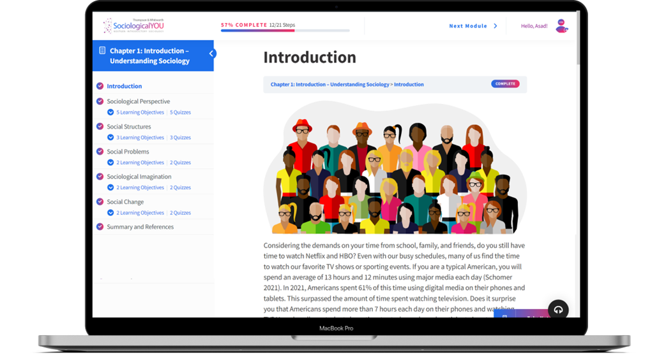

SociologicalYOU
Angela Thompson, Ph.D.
Keith Whitworth, Ph.D.
Introductory Sociology

Slide 2
Chapter 13
Marriage and Family: Changing Times

Slide 3
Modules
Module 1: The Sociological Perspective of Marriage and Family
Module 2: Marriage and Family Structural Issues
Module 3: Problems in the Family
Module 4: Understanding Family Dysfunctions in Context
Module 5: The Evolving Family
This PowerPoint does not cover every key term in Chapter 13.
Please read your textbook to see what is not covered in the PowerPoint.

Slide 4


Points to Ponder
How can sociology predict who individuals will or will not marry?
How has the institution of the family changed and what will it look like in the future?
How can the sociological imagination be applied to the topic of teen pregnancy?

Slide 5
Module 1: The Sociological Perspective of Marriage and Family
Choosing Your Mate
L.O. 13.1.1: Analyze the contemporary process of courtship.
Marriage: a socially constructed relationship that assumes financial and sexual cooperation between two people.
Family: a group of people connected by blood, marriage, adoption or agreed upon relationship. Families are socially constructed and historically changing.
Courtship: seeking the affections of an individual, or establishing contractual terms, usually with the intent of forming a long-term relationship.
Homogamy: marrying or establishing a relationship with someone with similar social and economic characteristics.
Cohabitation: a residential pattern in which a couple lives together without the benefit of legal marriage.

Slide 6
Module 1: The Sociological Perspective of Marriage and Family
Marriage Patterns
L.O. 13.1.2: Describe the variations of marriage patterns and forms.
Monogamy: a marriage between two people.
Serial Monogamy: a marriage pattern in which one person has multiple spouses but not at the same time.
Polygamy: a legally sanctioned or illegal marital relationship in which one person has more than one husband or wife at the same time.
Polygyny: a legally sanctioned or illegal marital relationship in which one man has multiple wives.
Polyandry: a legally sanctioned or illegal marital relationship in which one woman has multiple husbands.

Slide 7
Module 1: The Sociological Perspective of Marriage and Family
Marriage Patterns
L.O. 13.1.2: Describe the variations of marriage patterns and forms.
Patriarchal: lines of descent are traced through the paternal side of the family and characterized by male dominance.
Matriarchal: lines of descent are traced through the maternal side of the family and characterized by the mother as the head of the family.
Covenant Marriage: a legally binding marriage requiring pre-marital counseling and more limited grounds for divorce.
Endogamy: marrying or establishing a relationship within one’s own social group or category, as required by custom or law.
Exogamy: marrying or establishing a relationship outside of one’s own social group or category.

Slide 8
Module 2: Marriage and Family Structural Issues
Types of Families
L.O. 13.2.1: Analyze the types of families.
Basic Functions of Family
Reproduction
Physical, emotional, and economic security
Primary socialization of members into norms and values of society
Regulation of sexual activity
Providing a sense of place and position in society

Slide 9
Module 2: Marriage and Family Structural Issues
Types of Families
L.O. 13.2.1: Analyze the types of families.
Family of Orientation: the family in which you are raised and socialized as a result of birth, adoption, or a blended family.
Family of Procreation: the family you choose to create through marriage, agreed upon relationship, or the birth or adoption of children.
Kinship: social relationship pattern based on blood, marriage, or adoption.
Extended Family: a family that has other kin such as grandparents, aunts, uncles, and cousins living in the same household or nearby.
Nuclear Family: a family consisting of one or more parents and children.
Blended Family: a family in which one or both spouses have children from previous relationships.

Slide 10
Module 2: Marriage and Family Structural Issues
Types of Families
L.O. 13.2.1: Analyze the types of families.
Neolocal Residence: a living pattern in which a couple establishes their own residence independent of their parents.
Matrilocal Residence: a living pattern in which a couple resides with or near the wife’s parents.
Patrilocal Residence: a living pattern in which a couple resides with or near the husband’s parents.

Slide 11

Module 2: Marriage and Family Structural Issues
Family Diversity
L.O. 13.2.2: Discuss structural difference among diverse families.
African American Families
Asian American Families
Hispanic American Families
Middle Eastern American Families
Native American Families
White American Families

Slide 12
Module 2: Marriage and Family Structural Issues
Family Variations
L.O. 13.2.3: Describe the variations of families with and without children.
Childfree: individuals who choose not have children.
DINKS: Double Income, No Kids.
Childless: individuals who cannot have children for biological reasons.

Slide 13
Module 2: Marriage and Family Structural Issues
Parenting Styles
L.O. 13.2.4: Compare and contrast the different styles of parenting.
Styles of Parenting
Authoritarian: parents attempt to maintain strict control over their child’s life.
Permissive: parents give the child extensive freedom to make choices with little input from the parent.
Authoritative: parents offer a middle-ground combination of control and freedom.
Neglectful: parents have a low level of involvement in the child’s life.
Helicopter Parent: a well-meaning overprotective and overly involved parent that does not promote the characteristic of independence.
Free Range Parenting: a style of parenting that deemphasizes scheduling and supervision and emphasizes extreme independence.

Slide 14
Module 3: Problems in the Family
Divorce
L.O. 13.3.1: Identify the demographic and social factors that are more likely to result in divorce.
Divorce
Has long-term ramifications on society and numerous institutions within society.
Families that experience divorce exhibit more health, behavioral, and emotional problems.

Slide 15
Module 3: Problems in the Family
Family Abuse
L.O. 13.3.2: Examine the types of behavior associated with abuse in families.
Intimate Partner Violence (IPV): occurs between two people in a close relationship and includes current and former spouses and dating partners.
Physical violence
Sexual violence
Threats
Emotional abuse

Slide 16
Module 3: Problems in the Family
Family Abuse
L.O. 13.3.2: Examine the types of behavior associated with abuse in families.
Child Abuse: the physical, emotional, or sexual harm or mistreatment of a child.
Elder Abuse: the physical, emotional, sexual, and financial abuse or exploitation of an elder by a caregiver or trusted individual.
Substance Abuse: the use of alcohol, drugs, or other substances that results in negative consequences for the user and those around them.

Slide 17
Module 4: Understanding Family Dysfunctions in Context
Children Having Children
L.O. 13.4.1: Apply the sociological imagination to teen pregnancy.
Teenage Pregnancy

Slide 18

Module 4: Understanding Family Dysfunctions in Context
The Climbing Divorce Rate
L.O. 13.4.2: Examine divorce through the lens of the sociological imagination.
No fault divorce: marriages that can be dissolved without evidence of wrongdoing.

Slide 19
Module 5: The Evolving Family
Catalysts of Social Change
L.O. 13.5.1: Evaluate the catalysts for social changes of the family.
Catalysts of Social Change
Demographic Changes
Socioeconomic Changes
Public Policy
Technology

Slide 20
Module 5: The Evolving Family
Catalysts of Social Change
L.O. 13.5.1: Evaluate the catalysts for social changes of the family.
Sandwich Generation: those individuals that are raising children and caring for aging parents at the same time.
Family Medical Leave Act (FMLA): entitles most workers in the U.S. up to 12 weeks of unpaid job-protected medical leave for birth or adoption, although it does not cover those who work for smaller companies.

Slide 21
Module 5: The Evolving Family
The Future of Marriage and the Family
L.O. 13.5.2: Predict how marriage and family will change over the next decade.
Predicted Family Trends
Increase in cohabitation and more children born to unmarried couples.
More divorceless divorces.
More flash divorces.
More same-sex marriages and interracial marriages.
A wider marriage gap.

