Slide 1


SociologicalYOU
Angela Thompson, Ph.D.
Keith Whitworth, Ph.D.
Introductory Sociology

Slide 2
Chapter 14
Health, Illness, and Medicine: Society’s Magic Pill

Slide 3
Modules
Module 1: Health, Illness, and Medicine
Module 2: The Structures of Health, Illness, and Medicine
Module 3: Problems with Healthcare
Module 4: Health and the Sociological Imagination
Module 5: Changes in Your Healthcare
This PowerPoint does not cover every key term in Chapter 14.
Please read your textbook to see what is not covered in the PowerPoint.

Slide 4


Points to Ponder
Why is the health and life expectancy of Americans declining?
Why is the U.S. health care system ranked below many other developed country’s systems?
What social changes are occurring in the health care system?

Slide 5
Module 1: Health, Illness, and Medicine
The Social Construction of Health, Illness and Medicine
L.O. 14.1.1: Describe how health, illness, and medicine are socially constructed.
Medical Sociology: the sociological analysis of social interactions, organizations, and systems related to health, illness, and medicine.
Health: a state of complete physical, mental, and social well-being, and not merely the absence of disease or infirmity.

Slide 6
Module 1: Health, Illness, and Medicine
The Social Construction of Health, Illness and Medicine
L.O. 14.1.1: Describe how health, illness, and medicine are socially constructed.
Three Components to how Health and Illness are Socially Constructed
Culture
Personal Experience
Stakeholder Incentives

Slide 7
Module 1: Health, Illness, and Medicine
The Social Construction of Health, Illness and Medicine
L.O. 14.1.1: Describe how health, illness, and medicine are socially constructed.
Social Stigma: a negative label characterized by one or more personal traits that form a stereotype about the individual.
Medicalization: the process by which nonmedical problems become defined and treated as medical problems.
Medical Industrial Complex: the multibillion-dollar enterprise consisting of doctors, hospitals, nursing homes, insurance companies, drug manufacturers, and hospital supply and equipment companies.

Slide 8
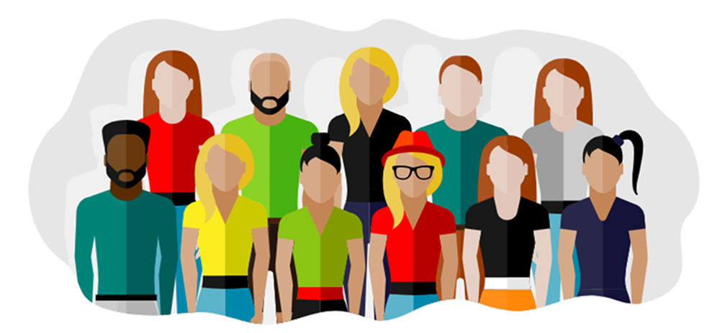
Module 1: Health, Illness, and Medicine
American Health and Lifestyles
L.O. 14.1.2: Describe the evolution of American health and lifestyles.
Chronic Diseases: long-lasting health problems that normally cannot be cured, only controlled, such as heart disease, cancer and strokes.

Slide 9
Table 14.1.1: The Ten Leading Causes of Death in the United States, 1900 and 2017
1900 | 2017
Influenza and pneumonia | Heart disease
Tuberculosis | Cancer
Gastroenteritis | Unintentional injuries
Heart disease | Chronic lower respiratory diseases
Cerebral hemorrhage | Stroke and cerebrovascular diseases
Kidney disease | Alzheimer’s disease
Accidents | Diabetes
Cancer | Influenza and pneumonia
Diseases of early infancy | Kidney disease
Diphtheria | Intentional self-harm (suicide)
Link to alternative text for this content

Slide 10
Module 1: Health, Illness, and Medicine
The Sick Role
L.O. 14.1.3: Describe the sick role and doctor-patient interactions.
Sick Role: the rights, and responsibilities of those who are ill.
You are exempt from your normal social roles and obligations.
You are not to be held personally responsible for your illness.
You should make every effort possible to get well.
You should seek professional medical help and follow their advice.

Slide 11
Module 2: The Structures of Health, Illness, and Medicine
Social Demography of Health and Illness
L.O. 14.2.1: Analyze the effects of social class, sex, and race on health and illness.
Infant Mortality Rate: the number deaths of children less than one year of age per 1,000 births.
Hispanic Mortality Paradox: the conditions by which Hispanics live longer despite lower income and health care access.

Slide 12
Module 2: The Structures of Health, Illness, and Medicine
Basic Structures of Healthcare in the U.S.
L.O. 14.2.2: Discuss the basic structures of the U.S. health care delivery system.
Employment-Based Health Insurance: system in which an employer pays all or part of the health insurance premiums for the employee.
Medicaid: government program established in 1965 funding health care for qualified persons living below the poverty level and/or who have disabilities.
Medicare: government program established in 1965 funding health care for the elderly, the disabled, and people receiving long-term treatment with dialysis.
Children’s Health Insurance Plan (CHIP): part of Medicaid and provides insurance to low-income children.

Slide 13
Module 2: The Structures of Health, Illness, and Medicine
Basic Structures of Healthcare Delivery Systems around the Globe
L.O. 14.2.3: Compare and contrast the U.S. and healthcare systems around the globe.
Socialized Medicine: medical and hospital care funded for all citizens by the government.

Slide 14
Module 3: Problems with Healthcare
Our Unhealthy System
L.O. 14.3.1: Examine issues that surround access to healthcare in the United States.
The Affordable Care Act (ACA)

Slide 15
Module 3: Problems with Healthcare
Why You Can’t Afford to be Sick
L.O. 14.3.2: Analyze the reasons behind the high cost of healthcare in the United States.
Annual health care spending per person:
The United States $9,000
Switzerland $6,787
Germany $5,119
France $4,367
Japan $4,152
Canada $4,056
The United Kingdom $3,971

Slide 16
Module 3: Problems with Healthcare
Are Good Doctors Enough?
L.O. 14.3.3: Understand the quality of the American healthcare system.
Quality Healthcare is:
Effective
Safe
Coordinated
Patient-Centered

Slide 17
Module 4: Health and the Sociological Imagination
The Vaccination Debate
L.O. 14.4.1: Explain the link between personal troubles and public health troubles.
Mental Illness: abnormal thoughts, behaviors, emotions or actions that are a threat to the individual or society.
Herd Immunity: a population's ability to resist disease as a result of a high percentage of its members being immune.

Slide 18
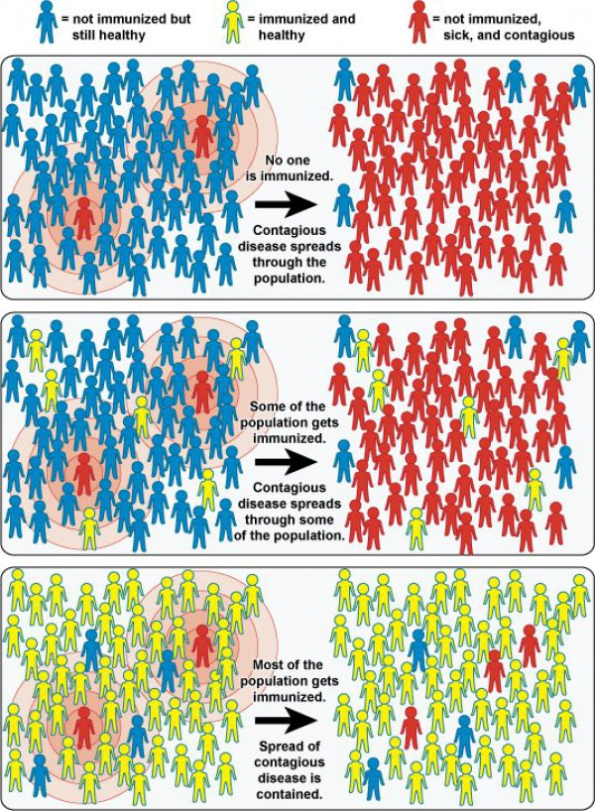
Figure 14.4.1: Contagion
Link to alternative text for this content

Slide 19
Module 4: Health and the Sociological Imagination
The Vaccination Debate
L.O. 14.4.1: Explain the link between personal troubles and public health troubles.
Reasons Parents Choose Not to Vaccinate their Children
They think the illness is rare or not that bad.
They fear vaccines might have side effects or cause autism.
They think the pharmaceutical companies and government are conspiring against citizens.
They trust the advice of their family and friends more than their doctor.

Slide 20
Module 5: Changes in Your Healthcare
Technology and Privacy
L.O. 14.5.1: Evaluate the social changes caused by the use of technology in healthcare.
Health Insurance Portability and Accountability Act (HIPAA)

Slide 21
Module 5: Changes in Your Healthcare
The Right to Die
L.O. 14.5.2: Assess the social changes associated with physician-assisted suicide.
Physician-Assisted Suicide: a process in which a doctor provides a terminally ill patient with the means to end their life at the time of the patient's choosing.
Dr. Jack Kevorkian

Slide 22
Module 5: Changes in Your Healthcare
The Future of Healthcare
L.O. 14.5.3: Predict how traveling for medical treatment may change healthcare.
Medical Tourism: the practice of traveling to another country to seek healthcare.

Slide 24
Accessibility Content: Text Alternatives for Images

Slide 25
The Ten Leading Causes of Death in the United States, 1900 and 2017 – Text Alternative
1900: Influenza and pneumonia, tuberculosis, gastroenteritis, heart disease, cerebral hemorrhage, kidney disease, accidents, cancer, diseases of early infancy, and diphtheria.
2017: Heart disease, cancer, unintentional injuries, chronic lower respiratory diseases, stroke and cerebrovascular diseases, Alzheimer’s disease, diabetes, influenza and pneumonia, kidney disease, and intentional self-harm (suicide).
Return to slide containing original content
United Instructors & Textbook Authors Co-op - SociologicalYOU - ISBN 978-1-64007-406-4 - All Rights Reserved

Slide 26
Contagion – Text Alternative
If no one is immunized, contagious disease spreads through the population.
If some of the population get immunized, contagious disease spreads through some of the population.
If most of the population get immunized, spread of contagious disease is contained.
Return to slide containing original content
United Instructors & Textbook Authors Co-op - SociologicalYOU - ISBN 978-1-64007-406-4 - All Rights Reserved

