Slide 1


SociologicalYOU
Angela Thompson, Ph.D.
Keith Whitworth, Ph.D.
Introductory Sociology

Slide 2
Chapter 2
Sociological Inquiry: For Inquisitive Minds

Slide 3
Modules
Module 1: Sociology: A Scientific Perspective
Module 2: The Structure of Research
Module 3: Problems with Sociological Research
Module 4: Applying the Sociological Imagination to Research Methods
Module 5: Research Methods in a Changing Society
This PowerPoint does not cover every key term in Chapter 2.
Please read your textbook to see what is not covered in the PowerPoint.

Slide 4


Points to Ponder
Why is a systematic and scientific perspective important to gain insight and understanding about our social world?
How is the scientific method used within sociological research?
How is social research used to address social problems?

Slide 5
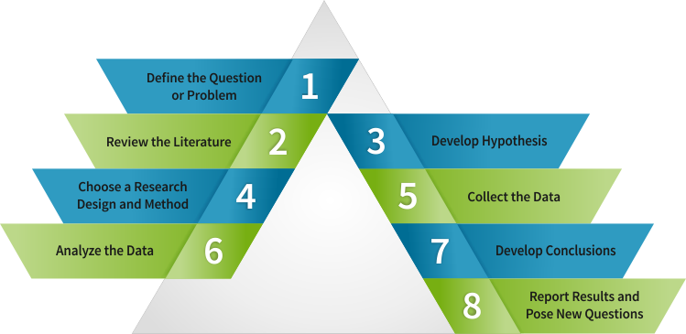
Module 1: Sociology: A Scientific Perspective
An Overview of the Scientific Method
L.O. 2.1.1: Explain the importance of the sequence and addressing all of the steps within the scientific method.
Scientific Method: consists of eight sequential steps in the process of conducting sociological research.

Slide 6
Module 1: Sociology: A Scientific Perspective
The 8 Steps of the Scientific Method
L.O. 2.1.2: List in order the eight steps of the scientific method.
Step 1: Define the Question or Problem
Step 2: Review the Literature
Step 3: Develop Hypotheses
Step 4: Choose a Research Design and Methods
Step 5: Collect the Data
Step 6: Analyze the Data
Step 7: Develop Conclusions
Step 8: Report Results and Pose New Questions

Slide 7
Module 1: Sociology: A Scientific Perspective
The 8 Steps of the Scientific Method
L.O. 2.1.2: List in order the eight steps of the scientific method.
Hypothesis: an educated guess about a relationship between two or more situations, events, or factors.
Independent Variable: a factor that causes a change in another variable.
Dependent Variable: a factor that is changed by another variable.
Validity: the extent that a study measures what it claims to measure.
Reliability: the extent to which a study yields the same result on repeated studies.

Slide 8
Module 1: Sociology: A Scientific Perspective
The 8 Steps of the Scientific Method
L.O. 2.1.2: List in order the eight steps of the scientific method.
Anonymity: concealing the identities of participants within the research project.
Confidentiality: guarding who has the right of access to the data provided by the participants.

Slide 9
Module 1: Sociology: A Scientific Perspective
The 8 Steps of the Scientific Method
L.O. 2.1.2: List in order the eight steps of the scientific method.
Quantitative Research Design: data collection using systematic and numerical measures to generalize across groups of people.
Qualitative Research Design: data collection using interviews and fieldwork, observation, photos, texts and other subjective measures.

Slide 10
Module 2: The Structure of Research
Quantitative Research Designs
L.O. 2.2.1: Describe the advantages and disadvantages of the quantitative methods.
Secondary Analysis: the use of data previously collected for other purposes.
Survey: a series of questions used to extract specific information from respondents.
Experiment: the use of two or more groups in which one group is exposed to a factor
being examined.
Experimental Group: the study subjects exposed to the independent variable.
Control Group: the subjects who are not exposed to the independent variable and are used as a reference group.
Longitudinal Design: the repeated observation of the same subjects over a duration of time.

Slide 11
Module 2: The Structure of Research
Qualitative Research Designs
L.O. 2.2.2: Summarize the advantages and disadvantages of the qualitative methods.
In-Depth Interview: a one-on-one, open-ended method that probes for deeper meaning and understanding of the responses of the interviewee.
Participant Observation: a method in which the researcher takes part in the social phenomenon being studied.
Ethnography: descriptive account of social life and culture in a particular social system derived from the researcher being embedded over a period of time within the group, organization, or community.
Focus Group: a small group interview or guided discussion using a moderator to gain insight of the participants’ opinions on specific topics.
Groupthink: the tendency of group members to yield to the desire of consensus rather than expressing individual or alternative ideas.

Slide 12
Module 2: The Structure of Research
Quantitative Methods | Advantages | Disadvantages
Secondary Analysis | Existing data is plentiful and study can be conducted quickly | Available data may not fit research questions
Surveys | Cost-effective and convenient | Inflexible design and potential low response rate
Experiments | More control over design and stronger validity and reliability | Inability to generalize data
Longitudinal | Provides broad and detailed data | Expensive and requires a multi-year commitment
Quantitative versus Qualitative Methods
L.O. 2.2.3: Contrast the quantitative and qualitative research methods.
Table 2.2.3: Advantages and Disadvantages of Research Methods
Access the alternative text for this content

Slide 13
Table 2.2.3: Advantages and Disadvantages of Research Methods
Longitudinal | Provides broad and detailed data | Expensive and requires a multi-year commitment
Qualitative Methods | Advantages | Disadvantages
In-depth Interviews | Ability to explore different angles and levels | Transcribing field notes can be time-consuming and focuses on individuals
Participant Observation | Unrestricted access to observe social behavior | Difficult to document details and potentially can be unethical
Focus Groups | Ease of implementation and quick results | Groupthink can occur and moderators can skew the results
Content Analysis | Does not involve human subjects and cost-effective | Researchers must “read between the lines”
Access the alternative text for this content

Slide 14
Module 3: Problems with Sociological Research
Research Challenges
L.O. 2.3.2: Describe potential problems with sociological research and how to address them.
Honesty and Ethics
Hawthorne Effect: the tendency of people to change their behavior when they know they are being watched.
Ethics: principles of conduct about how you are supposed to behave in a given situation.
Debriefing: a follow-up review of the research.
Code of Ethics: a set of guidelines of appropriate behavior established by an organization for its members to follow.

Slide 15

Module 3: Problems with Sociological Research
Research Challenges
L.O. 2.3.2: Describe potential problems with sociological research and how to address them.
Objectivity and Sample Selection
Objectivity (Value Neutrality): the effort to eliminate bias from the research.
Sample of Convenience: a research sample that is based on the ease of accessibility of the research subjects.

Slide 16

Module 4: Applying the Sociological Imagination to Research Methods
Case Studies
L.O. 2.4.1: Illustrate the sociological imagination with case studies.
Case Study: an in-depth analysis of a particular person, place, or event over a significant period of time.

Slide 17
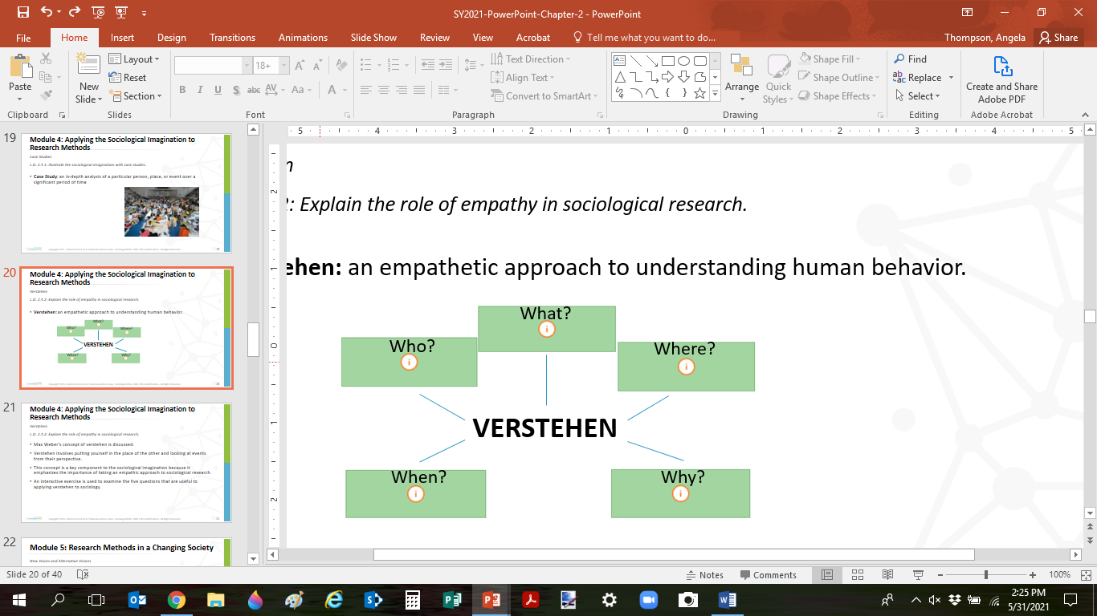
Module 4: Applying the Sociological Imagination to Research Methods
Verstehen
L.O. 2.4.2: Explain the role of empathy in sociological research.
Verstehen: an empathetic approach to understanding human behavior.

Slide 18

Module 5: Research Methods in a Changing Society
New Voices and Alternative Visions
L.O. 2.5.1: Evaluate the theoretical changes that have impacted sociological research.
Anne Julia Cooper (1858-1964)
Prominent African American author and educator
A Voice from the South: By a Woman from the South
Originated Black Feminism

Slide 19

Module 5: Research Methods in a Changing Society
New Voices and Alternative Visions
L.O. 2.5.1: Evaluate the theoretical changes that have impacted sociological research.
Beatrice Potter Webb (1858-1943)
English sociologist
Researcher and teacher
Social reform of British welfare system

Slide 20

Module 5: Research Methods in a Changing Society
New Voices and Alternative Visions
L.O. 2.5.1: Evaluate the theoretical changes that have impacted sociological research.
Jane Addams (1860-1935)
Founded Hull House
Addressed needs of families, public health, and world peace
First American woman to be awarded Noble Prize
Founded Social Work

Slide 21

Module 5: Research Methods in a Changing Society
New Voices and Alternative Visions
L.O. 2.5.1: Evaluate the theoretical changes that have impacted sociological research.
Sophonisba Breckinridge (1866-1948)
First woman admitted to the Kentucky bar association
Worked with Chicago Hull House project
Focused efforts on family and public welfare

Slide 22

Module 5: Research Methods in a Changing Society
New Voices and Alternative Visions
L.O. 2.5.1: Evaluate the theoretical changes that have impacted sociological research.
Marianne Weber (1870-1954)
Sociologist and social analyst
German feminist movement
First woman elected to the German parliament

Slide 23
Module 5: Research Methods in a Changing Society
New Voices and Alternative Visions
L.O. 2.5.1: Evaluate the theoretical changes that have impacted sociological research.
Liberal Feminism
Problem: Sex discrimination and sex-biased laws are a product of prejudice and stereotyping by society.
Solution: Reform of sex-biased laws, challenging sexism, improving rights and expanding opportunities in the society.
Strategy: Reducing gender roles, increasing education, removing discriminatory legislation, implementing laws that address sexism and increasing resources to areas impacted by biological differences (e.g. childcare).

Slide 24
Module 5: Research Methods in a Changing Society
New Voices and Alternative Visions
L.O. 2.5.1: Evaluate the theoretical changes that have impacted sociological research.
Radical Feminism
Problem: Intersection of various types of oppression in the society and the patriarchal control men have over women’s reproduction and sexuality is the root of the problem.
Solution: Challenging the power structure in society, addressing the intersectionality of oppression and liberating women from their reproductive role.
Strategy: Separating the sexes, redefining private space and working relationships, challenging the oppressors, reclaiming women’s voices, and using technology to freewomen from the reproductive process.

Slide 25
Module 5: Research Methods in a Changing Society
New Voices and Alternative Visions
L.O. 2.5.1: Evaluate the theoretical changes that have impacted sociological research.
Marxist/Socialist Feminism
Problem: The role of patriarchy and capitalism in society.
Solution: Major changes in political and economic systems.
Strategy: Strengthening the connection between home and workplace, establishing more autonomous women’s organizations, increasing women’s representation in politics, and working towards future political goals in what is known as pre-figurative politics.

Slide 26
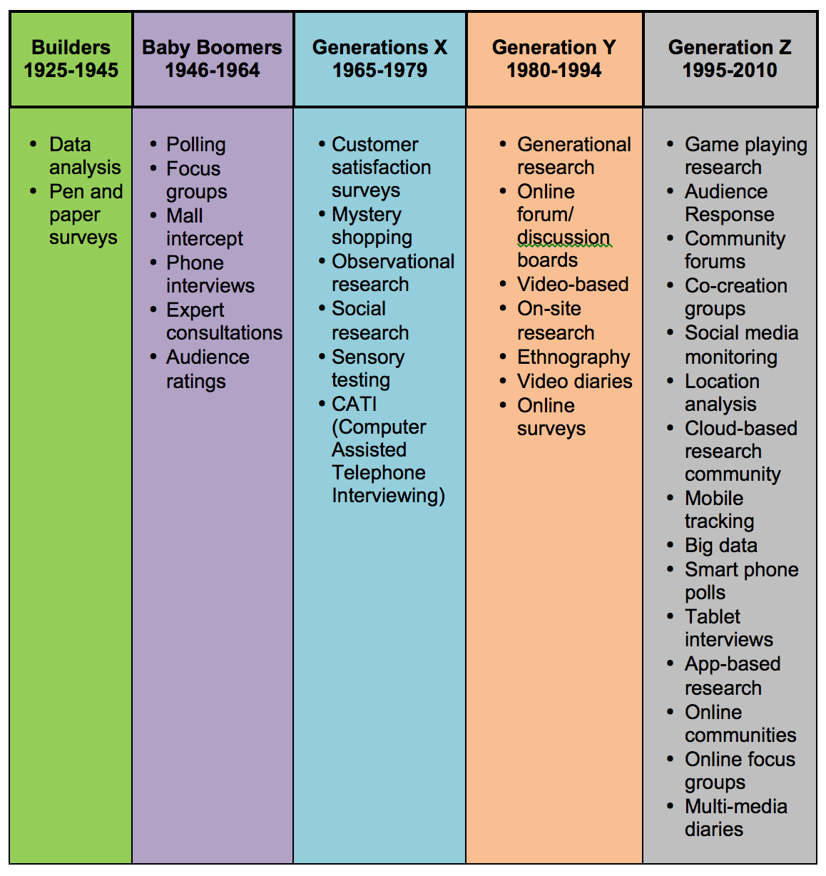
Figure 2.5.2: Emerging Research Methods
Point and Click Sociology
L.O. 2.5.2: Demonstrate how technology has changed the research process.
Link to alternative text for this content

Slide 28
Accessibility Content: Text Alternative for Images

Slide 29
Quantitative Research Methods and General Characteristics – Text Alternative
Quantitative research methods include secondary analysis, surveys, experiments, and longitudinal studies. The purpose of quantitative research is to produce results that are generalizable to a larger population. In quantitative research, sample size is large and representative of the larger population, data collection is structured and statistical, and outcomes allow for recommendations for policy.
Return to slide containing original content
United Instructors & Textbook Authors Co-op - SociologicalYOU - ISBN 978-1-64007-406-4 - All Rights Reserved

Slide 30
Qualitative Research Methods and General Characteristics – Text Alternative
Qualitative research methods include in-depth interviews, participant observation, focus groups, and content analysis. The purpose of qualitative research is to uncover underlying reason, opinions, and trends. In qualitative research, sample size is small and non-representative, data collection is less structured and statistical, and outcomes are exploratory and investigative.
Return to slide containing original content
United Instructors & Textbook Authors Co-op - SociologicalYOU - ISBN 978-1-64007-406-4 - All Rights Reserved

Slide 31
Advantages and Disadvantages of Research Methods – Text Alternative
Quantitative methods – including secondary analysis, surveys, experiments, and longitudinal studies – have many advantages and disadvantages. Secondary analysis can be conducted quickly when existing data is plentiful, but available data does not always fit research questions. Surveys are cost-effective, time-efficient, and convenient; however, the design is inflexible and there is a potential for low response rate. Experiments allow for more control over the design and produce stronger validity and reliability, but data is not generalizable. Longitudinal studies produce broad and detailed data, but are expensive and require a multi-year commitment.
Qualitative methods – including in-depth interviews, participant observation, focus groups, and content analysis also have advantages and disadvantages. In-depth interviews allow researchers to explore different angles and levels, but transcribing field notes can be time consuming and data only focuses on individuals. Participant observation allows for unrestricted access to observe social behavior, but it can be difficult to document details and observation may pose ethical concerns. Focus groups is easy to implement and produces quick results, but groupthink can occur and moderators can skew the data. Content analysis is cost-effective and does not involve human subjects, but it forces researchers to “read between the lines.”
Return to slide containing original content
United Instructors & Textbook Authors Co-op - SociologicalYOU - ISBN 978-1-64007-406-4 - All Rights Reserved

Slide 32
Emerging Research Methods – Text Alternative
List of research methods used in each generation.
Builders (1925-1945): Data analysis and pen and paper surveys.
Baby Boomers (1946-1964): Research methods include polling, focus groups, mall intercept, phone interviews, expert consultations, and audience ratings.
Generation X (1965-1979): Customer satisfaction surveys, mystery shopping, observational research, social research, sensory testing, CATI (Computer Assisted Telephone Interviewing).
Generation Y (1980-1994): Generational research, online forum/discussion boards, video-based, on-site research, ethnographies, video diaries, and online surveys.
Generation Z (1995-2010): Game playing research, audience response, community forums, co-creation groups, social media, monitoring, location analysis, cloud-based research community, mobile tracking, big data, smart phone polls, tablet interviews, app-based research, online communities, online focus groups, and multi-media diaries.
Return to slide containing original content
United Instructors & Textbook Authors Co-op - SociologicalYOU - ISBN 978-1-64007-406-4 - All Rights Reserved

