Slide 1


SociologicalYOU
Angela Thompson, Ph.D.
Keith Whitworth, Ph.D.
Introductory Sociology

Slide 2
Chapter 3
Culture: Defined by Everyday Reality

Slide 3
Modules
Module 1: Analyzing Culture
Module 2: Structural Elements of Culture
Module 3: The Development of Social Problems within Cultures
Module 4: Applying the Sociological Imagination: Experiencing Culture
Module 5: Culture and Change
This PowerPoint does not cover every key term in Chapter 3.
Please read your textbook to see what is not covered in the PowerPoint.

Slide 4


Points to Ponder
What are four types of culture and four basic elements of culture?
Why is understanding culture important in your everyday life?
How and why is culture changing around the world?

Slide 5
Module 1: Analyzing Culture
Types of Culture
L.O. 3.1.1: Discuss the types of culture.
Culture: the socially learned and shared ideas, behaviors and material components of a society.
Material Culture: the physical artifacts that represent components of society.
Nonmaterial Culture: ideas and symbols that represent components of society.
Ideal Culture: the ideals and values that a society professes to believe.
Real Culture: the actual behavior of members of society.
Culture Shock: surprise, disorientation, or fear when encountering a new culture.

Slide 6
Module 2: Structural Elements of Culture
Symbols and Language
L.O. 3.2.1: Explain how symbols and language are key elements of culture and help form social structure.
Symbols: an idea or object that has a shared meaning to groups of people.
Language: words and symbols used to communicate.
Verbal Language: a system of spoken and written words.
Nonverbal Language: a system of communication using symbols such as facial expressions, gestures, and proximity of the body.
Emoticons: a symbol that is a type of shorthand, which is a means of expressing emotions and attitude within text-based communications.
Sapir-Whorf Theory: a theoretical perspective that suggests that people view society through the framework of language.

Slide 7
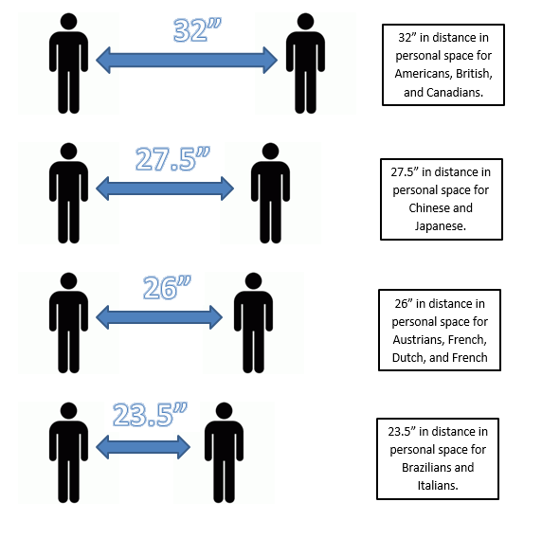
Figure 3.2.1: Personal Distances by Region
Personal Space: the physical region
surrounding an individual that is considered private.
Link to alternative text for this content

Slide 8
Module 2: Structural Elements of Culture
Beliefs and Views
L.O. 3.2.2: Describe how beliefs and values are key elements of culture and help form social structure.
Beliefs: ideas generally held to be true within society.
Values: collective ideas about what is desirable and undesirable in society.

Slide 9
Robin M. Williams, Jr.'s Basic American Values
Equal opportunity
Achievement and success
Material comfort
Activity and work
Practicality and efficiency
Nationalism
Process and progress
Science and rationality
External conformity
Moral orientation
Democracy and enterprise
Freedom
Humanitarian motives
Racism
Group conformity

Slide 10
Module 2: Structural Elements of Culture
Norms and Cultural Transmission
L.O. 3.2.3: Discuss how norms are key elements of culture and help form social structure.
Norms: established guidelines and expectations of behavior.
Folkways: informal and common norms that guide everyday behavior.
Mores: informal norms based upon moral and ethical factors.
Laws: formal and legal rules enforced by the state.
Taboos: norms that if violated cause revulsion and the most severe social sanctions.
Cultural Transmission: the means by which culture is passed from generation to generation.
Sanctions: a punishment or reward that supports socially approved norms.

Slide 11
Table 3.2.1: Global Infractions and Sanctions
Infraction | Sanction
Public displays of affection in Dubai. | In 2017 this resulted in one month in prison for an Egyptian man and Moroccan woman.
Naming a teddy bear Mohammed in Sudan. | This could have meant 40 lashes for a British woman, but after international intervention, she was released from jail after eight days on the condition she leaves the country.
Defacing money or licking a stamp in Thailand as both have the image of the King on them. | This can land you six months in jail.
Throwing a shoe at another person in Iraq. | An Iraqi man was given a 3-year sentence and it was later reduced to one year and he only served 9 months because of good behavior.
Link to alternative text for this content

Slide 12
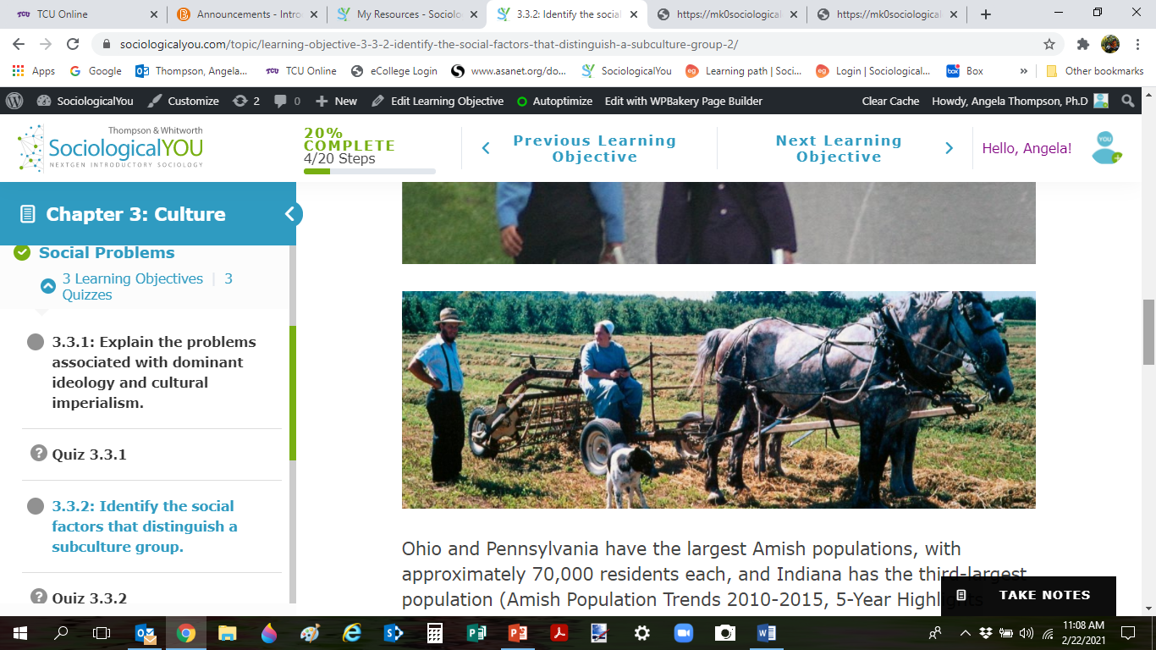
Module 3: The Development of Social Problems within Cultures
Subcultures: Amish Kids Gone Wild
L.O. 3.3.2: Identify the social factors that distinguish a subculture group.
Subcultures: a distinct set of cultural characteristic that are shared by a minority of people in the society.

Slide 13
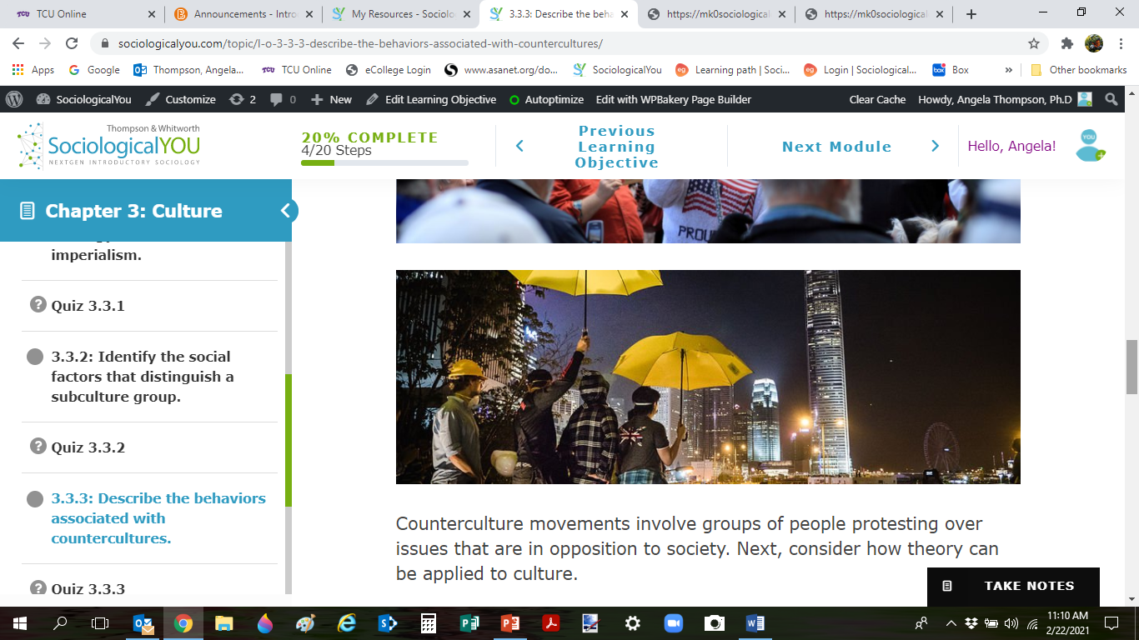
Module 3: The Development of Social Problems within Cultures
Countercultures: Working towards Social Transformation
L.O. 3.3.3: Describe the behavior associated with countercultures.
Countercultures: groups that are in opposition or contrast with the majority of the members of a society.

Slide 14
Module 4: Applying the Sociological Imagination: Experiencing Culture
Cultural Universals
L.O. 3.4.1: Apply the sociological imagination to cultural universals.
Cultural Universals: aspects of culture that are found in all societies.
Social Facts: social patterns that are external to individuals and greatly influence our way of thinking and behaving in the society.

Slide 15

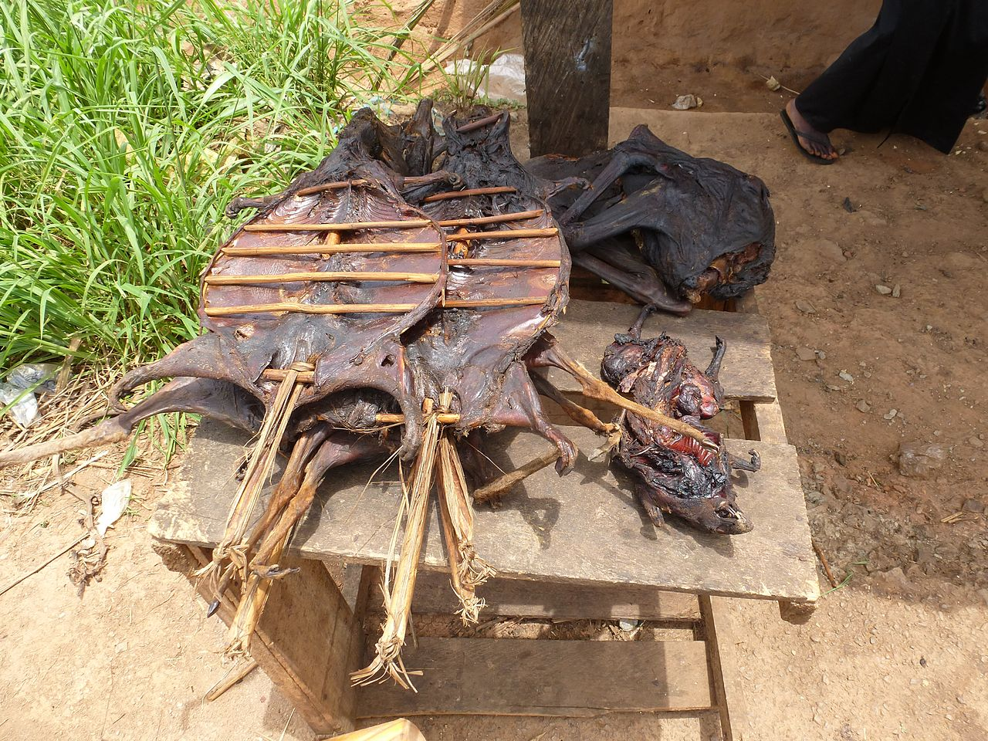
Module 4: Applying the Sociological Imagination: Experiencing Culture
Ethnocentrism
L.O. 3.4.2: Illustrate the relationship between the sociological imagination and ethnocentrism.
Ethnocentrism: judging another culture by one’s own standards.

Slide 16
Module 4: Applying the Sociological Imagination: Experiencing Culture
Cultural Relativism
L.O. 3.4.3: Link the sociological imagination to cultural relativism.
Cultural Relativism: understanding another culture from their standards.

Slide 17
Module 5: Culture and Change
The Process of Change: Technology and Globalization
L.O. 3.5.1: Evaluate how cultural diffusion, cultural lag and cultural leveling are catalysts for social change within culture and technology.
Cultural Diffusion: the spread of norms, values, knowledge, symbols, and material components from one society to another.
Cultural Lag: the process by which technological development and progress outpace current norms, values, knowledge, symbols, and material components of society.
Cultural Leveling: the process of cultures becoming similar as a result of factors such as media and globalization.

Slide 18
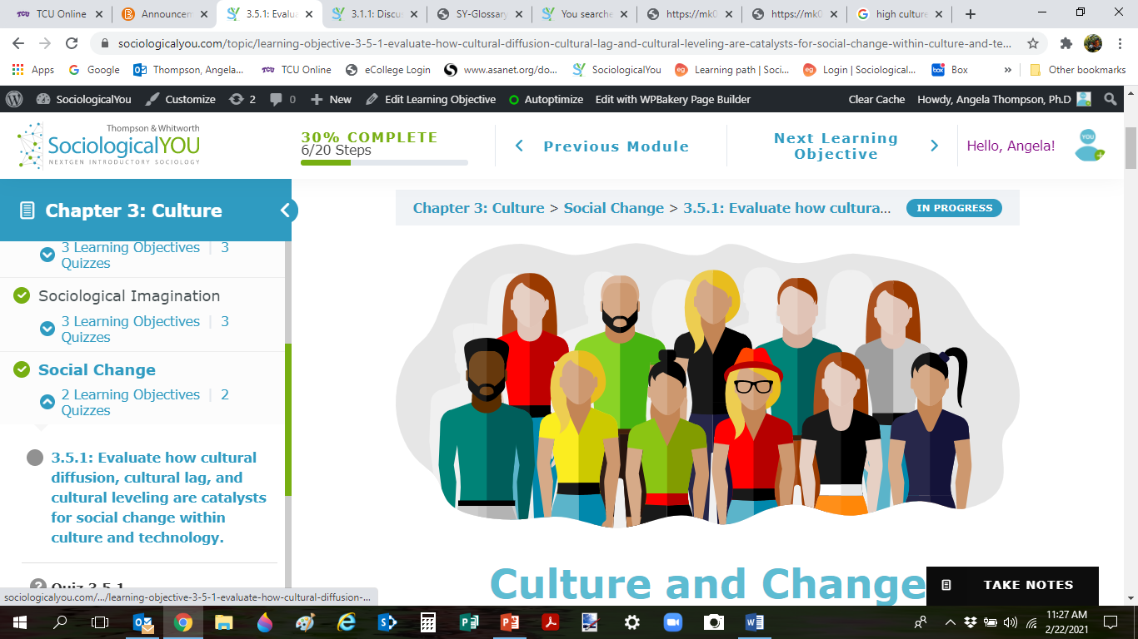
Module 5: Culture and Change
Popular and High Culture
L.O. 3.5.2: Demonstrate how popular culture and high culture change over time.
Popular Culture: cultural characteristics adopted, imitated, and idolized by the masses.
High Culture: consists of cultural characteristics associated with the dominant and elite members of society.

Slide 20
Accessibility Content: Text Alternatives for Images

Slide 21
Personal Distances by Region – Text Alternative
32” is the distance in personal space for Americans, British, and Canadians.
27.5” in distance in personal space for Chinese and Japanese.
26” in distance in personal space for Austrians, French, and Dutch.
23.5” in distance in personal space for Brazilians and Italians.
Return to slide containing original content
Copyright 2021 - United Instructors & Textbook Authors Co-op - SociologicalYOU - ISBN 978-1-64007-406-4 - All Rights Reserved

