Slide 1
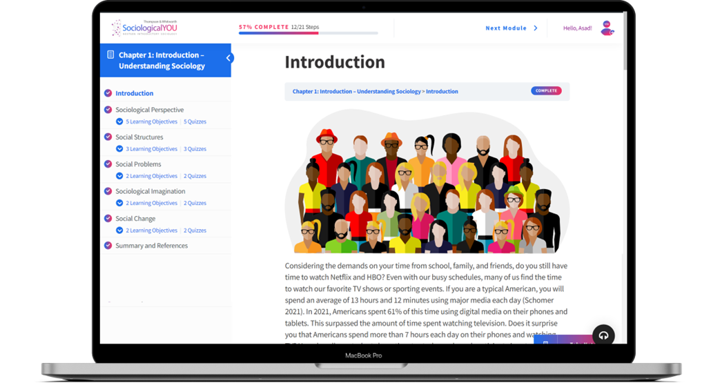

SociologicalYOU
Angela Thompson, Ph.D.
Keith Whitworth, Ph.D.
Introductory Sociology

Slide 2
Chapter 4
Socialization: Are We Merely Byproducts of Society?

Slide 3
Modules
Module 1: Socialization and the Sociological Perspective
Module 2: The Structural Foundation of Society: Agents of Socialization
Module 3: When Socialization Goes Wrong
Module 4: Applying the Sociological Imagination to the Stages of Life
Module 5: The Process of Becoming You
This PowerPoint does not cover every key term in Chapter 4.
Please read your textbook to see what is not covered in the PowerPoint.

Slide 4


Points to Ponder
Which side of the nature vs. nurture debate do you fall on?
How are we molded and shaped by society?
What is meant by the phrase, “we are all actors on the stage of life?”

Slide 5
Module 1: Socialization and the Sociological Perspective
The Debate Continues: Nature vs. Nurture
L.O. 4.1.1: Summarize both sides of the nature versus nurture debate.
Socialization: the process by which one learns the appropriate attitudes and behaviors within a culture.
Self: an individual’s nature and identity resulting from reflections on social interactions.

Slide 6
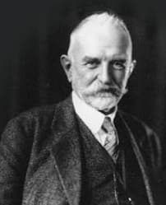
Module 1: Socialization and the Sociological Perspective
Theories of the Self: Mead
L.O. 4.1.2: Apply Mead’s socialized Self to a personal encounter or situation.
“I”: the unsocialized or acting self, made up of personal desires and needs.
“Me”: the social self, made up of the internalized attitudes of others.
Preparatory Stage: imitation of others, an infant merely imitates surrounding people.
Play Stage: pretending to be other people, incorporates role-playing.
Significant Other: individuals who are important to the development of self.
Game Stage: taking the role of multiple people at one time.
Generalized Other: the process of internalizing societal norms and expectations.

Slide 7
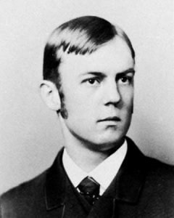
Module 1: Socialization and the Sociological Perspective
The Looking Glass Self: Cooley
L.O. 4.1.3: Compare and contrast Cooley’s perspective of the socialized Self with Mead’s socialized Self.
Looking-Glass Self: the process of imagining the reaction of others toward oneself.
Imagine how you appear to others.
Imagine the judgment of your appearance by others.
Developing a Self concept that is either favorable or unfavorable based on point 1 and 2.

Slide 8
Module 2: The Structural Foundation of Society: Agents of Socialization
The Family and Peers
L.O. 4.2.1 Analyze the degree of influence family and peers as agents of socialization have had upon your life.
Agents of Socialization: individuals, groups, and institutions that influence the attitudes and behaviors of members of society.
Social Learning Theory: the process of learning from one another in a social context as a result of observation and imitation.
Peer Groups: social groups consisting of members with common interests, social rank, and similar ages.

Slide 9
Module 2: The Structural Foundation of Society: Agents of Socialization
Media
L.O. 4.2.3 Evaluate how media has specifically impacted you as an agent of socialization.
Digital Natives: those individuals who have always experienced a totally digital world.
Digital Immigrants: people who did not grow up with current technologies and had to learn and adapt to technology and social media later in life.

Slide 10
Module 2: The Structural Foundation of Society: Agents of Socialization
Religion and Government
L.O. 4.2.4 Analyze how religion and government as agents of socialization impact all members of society.

Slide 11
Module 3: When Socialization Goes Wrong
Family Socialization: From Neglect to Protection
L.O. 4.3.1: Identify the role of family in the socialization of children.
Feral Children: children who are isolated and neglected such that they are raised without socialization.
Genie the Wild Child

Slide 12
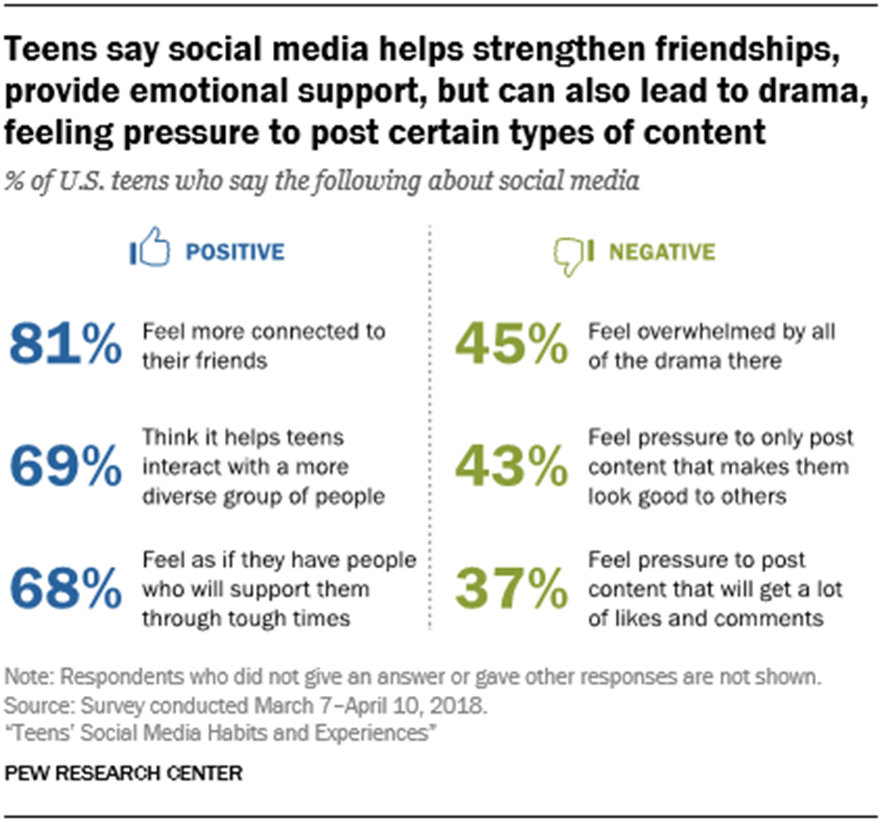
Module 3: When Socialization Goes Wrong
Too Much Media?
L.O. 4.3.2: Describe problems associated with excessive media consumption by children and teens.
Figure 4.3.1
Teen Social Media Survey

Slide 13
Module 3: When Socialization Goes Wrong
Social Control Gone Wrong
L.O. 4.3.3: Analyze problems that can occur when socialization goes wrong in religion and the military.
Total Institutions: an isolated group with strict rules and regulations whose goal is to control every aspect of its members’ lives.
Resocialization: an identity transformation in which social norms and roles are altered or replaced.
Degradation Ceremony: an event, ceremony or rite of passage used to break down people and make them more accepting of a total institution.
Anticipatory Socialization: the process of learning different behaviors or activities in an effort to aspire to group membership.
Rite of Passage: a ceremony or ritual used to mark a change in age or social status.

Slide 14
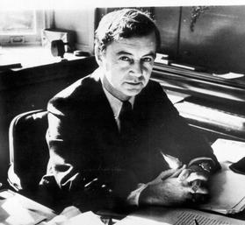
Module 4: Applying the Sociological Imagination to the Stages of Life
Goffman’s Dramaturgy: A One-Act Play
L.O. 4.4.1: Explain the connection between the sociological imagination and socialization.
Dramaturgy: the theory that we are all actors on the stage of life, and as such we divide our world based on what we let the others see or not see of us.
Front Stage: a persons’ public life that they reveal to the world.
Back Stage: a persons’ private world that they choose not to reveal.
Impression Management: an effort to control the impression others have of us.

Slide 15
Module 5: The Process of Becoming You
The Life Course
L.O. 4.5.1: Evaluate the sequence of social change throughout the life course.
Life Course Perspective: a series of social changes that a person experiences over the course of their lifetime.
Childhood
Adolescence
Young Adulthood
Middle-Adult Years
Senior Years

Slide 16
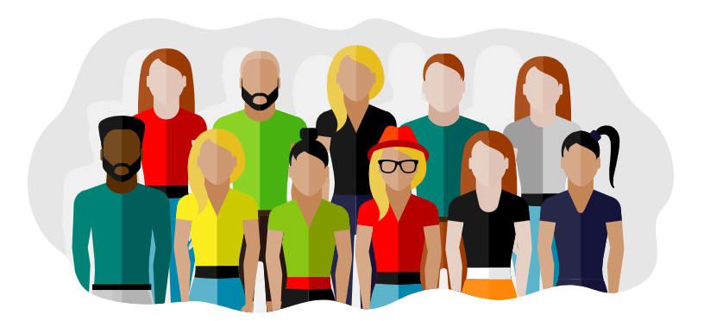
Module 5: The Process of Becoming You
Socialization and New Technologies
L.O. 4.5.2: Predict how technology will impact socialization over the next decade.

Slide 17
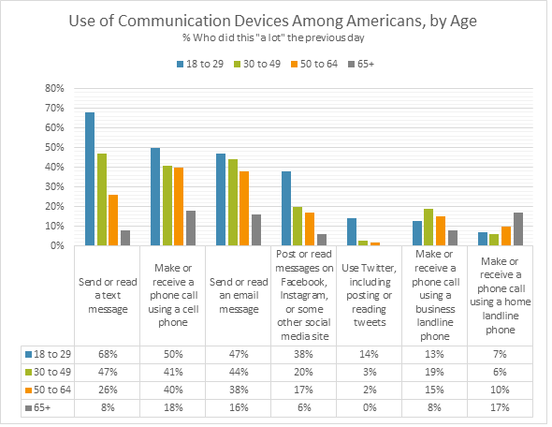
Table 4.5.2: Use of Communication Devices Among Americans, by Age
Link to alternate text for this content

Slide 19
Accessibility Content: Text Alternatives for Images

Slide 20
Teen Social Media Survey – Text Alternative
According to Pew Research Center, “teens say social media helps strengthen friendships, provide emotional support, but can also lead to drama, feeling pressure to post certain types of content.”
81% of teens feel more connected to their friends.
69% of teens think social media helps teens interact with a more diverse group of people.
68% of teens feel as if they have people who will support them through tough times.
45% of teens feel overwhelmed by all the drama on social media.
43% of teens feel pressure to only post content that makes them look good to others.
37% of teens feel pressure to post content that will get a lot of likes and comments.
Return to slide containing original content
Copyright 2020 - United Instructors & Textbook Authors Co-op - SociologicalYOU - ISBN 978-1-64007-406-4 - All Rights Reserved

Slide 21
Use of Communication Devices Among Americans, by Age – Text Alternative
Older cohorts tend to adopt new technologies more slowly, but the trend is that for most technologies, they are closing the gap rather than getting further left behind.
Data reflects the percent of respondents in each age group who utilized communication devices in the specified way “a lot” the previous day:
Send or read a text message: 18-29 (68%), 30-49 (47%), 50-64 (26%), 65+ (8%).
Make or receive a phone call using a cell phone: 18-29 (50%), 30-49 (41%), 50-64 (40%), 65+ (18%).
Send or read an email message: 18-29 (47%), 30-49 (44%), 50-64 (38%), 65+ (16%).
Post or read messages on Facebook, Instagram, or some other media site: 18-29 (38%), 30-49 (20%), 50-64 (17%), 65+ (6%).
Use Twitter, including posting or reading tweets: 18-29 (14%), 30-49 (3%), 50-64 (2%), 65+ (0%).
Make or receive a phone call using a business or landline phone: 18-29 (13%), 30-49 (19%), 50-64 (15%), 65+ (8%).
Make or receive a phone call using a home landline phone: 18-29 (7%), 30-49 (6%), 50-64 (10%), 65+ (17%).
Return to slide containing original content
United Instructors & Textbook Authors Co-op - SociologicalYOU - ISBN 978-1-64007-406-4 - All Rights Reserved

