Slide 1
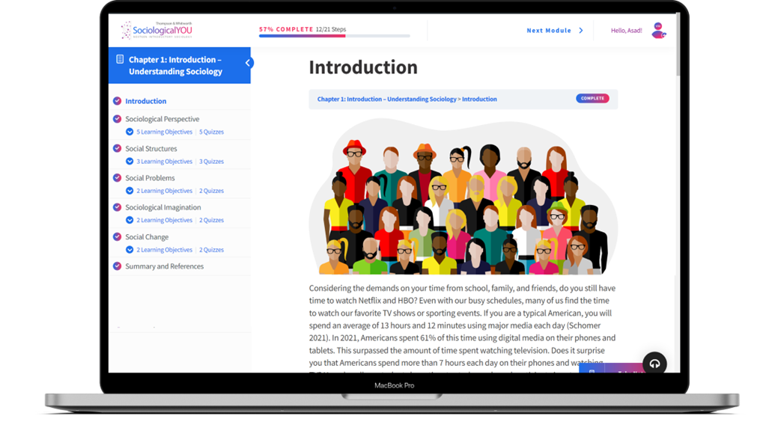

SociologicalYOU
Angela Thompson, Ph.D.
Keith Whitworth, Ph.D.
Introductory Sociology

Slide 2
Chapter 5
Social Interaction: All the World is a Stage

Slide 3
Modules
Module 1: Understanding Your Social Interactions
Module 2: The Relationship Between Interaction and Structure
Module 3: Interactions: Successes and Failures
Module 4: The Personal and Public Nature of Social Interaction
Module 5: Communication and Change
This PowerPoint does not cover every key term in Chapter 5.
Please read your textbook to see what is not covered in the PowerPoint.

Slide 4


Points to Ponder
Why is it important to understand and explain how individuals and groups interact within society?
How do social interactions produce and maintain social structure?
How can the sociological imagination help us understand problematic social interactions?

Slide 5
Module 1: Understanding Your Social Interactions
Social Context, Perceptions, and Attributions
L.O. 5.1.1: Explain the three processes involved in social interaction.
Sociological Perspective: the process of understanding and explaining how individuals and groups interact within society.
Social Interaction: interpersonal relationships between two or more persons.
Social Context: the environment of the interaction.
Definition of the Situation: an individual’s interpretation of a social setting.
Social Construction of Reality: an individual’s perception of one’s social world is determined or influenced by social interaction.
Social Attribution: is an explanation of how others appear, behave, or are motivated.

Slide 6
Module 1: Understanding Your Social Interactions
Ethnomethodology
L.O. 5.1.2: Apply findings from ethnomethodology to your own social interactions.
Ethnomethodology: the study of people’s methods as it relates to the formation of society.
Breaching: purposely violating social norms to examine individual’s reactions.

Slide 7
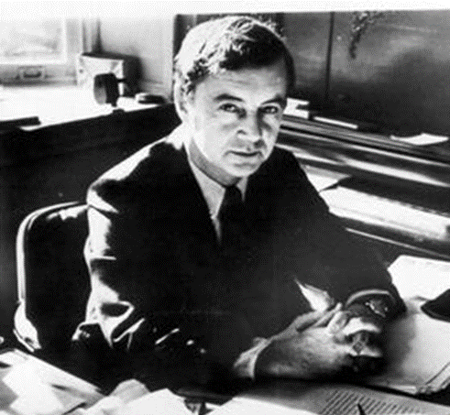
Module 1: Understanding Your Social Interactions
Dramaturgy
L.O. 5.1.3: Apply findings from dramaturgy to your own social interactions.
Erving Goffman (1922-1982)
Dramaturgy: the theory that we are all actors on the stage of life, and as such we divide our world based on what we let the others see or not see of us.
Face Work: the effort exerted by both actors during an interaction to get through unanticipated events without casting an undesirable light or disrupting the relationship of the participants.

Slide 8
Module 1: Understanding Your Social Interactions
Social Exchange Theory
L.O. 5.1.4: Apply findings from the social exchange theory to your own interactions.
Social Exchange: the process by which social decisions are based on perceived costs and benefits.
Rewards – Costs = Outcome

Slide 9
Module 2: The Relationship Between Interaction and Structure
Social Status
L.O. 5.2.1: Explain how your ascribed, achieved, and master statuses influence your social interactions.
Social Status: an individual’s position or rank within a social system.
Status Set: the collection of statuses held at one time.
Ascribed Status: a position within a social system that is assigned based upon characteristics such as sex, race, or economics.
Achieved Status: a position within a social system that is gained through merit.
Master Status: the social position central to your identity.

Slide 10
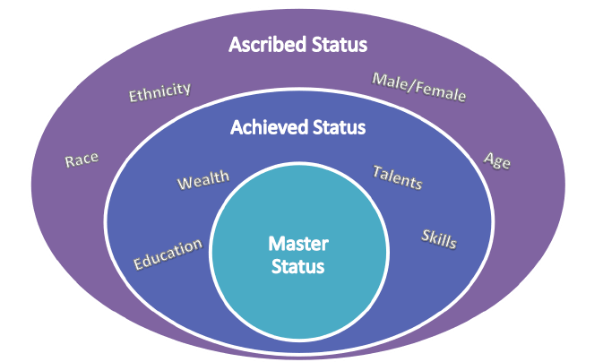
Figure 5.2.1: Statuses Overview
Link to alternative text for this content

Slide 11
Module 2: The Relationship Between Interaction and Structure
Social Roles
L.O. 5.2.2: Discuss how social roles influence your social interactions.
Social Roles: expected patterns of behaviors for specific statuses and positions.
Role Set: the complement of role-relationships within a single status.
Role Strain: incompatible demands and expectations within a single role.
Role Conflict: competing demands resulting from two or more statuses.

Slide 12
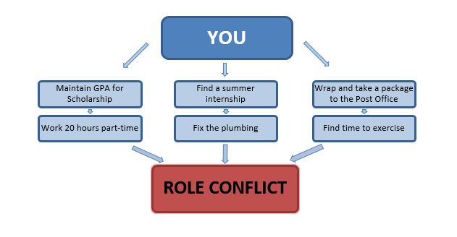
Figure 5.2.1: Role Conflict
Link to alternative text for this content

Slide 13
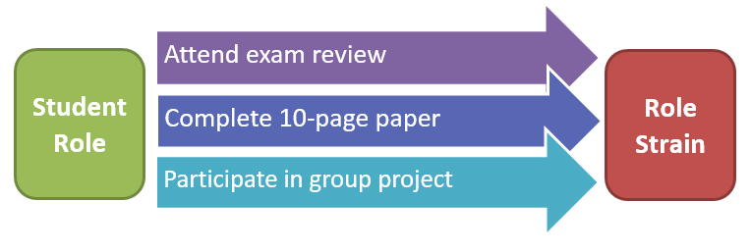
Figure 5.2.2 Role Strain
Link to alternative text for this content

Slide 14
Module 2: The Relationship Between Interaction and Structure
Role Exit
L.O. 5.2.3: Apply the stages of the role exit to a personal experience.
Role Exit: the process of disengaging from significant roles.
Doubt role commitments
Seek alternatives
Turning point
Create an ex-role

Slide 15

Module 3: Interactions: Successes and Failures
Social Institutions: Our Connections to Society
L.O. 5.3.1: Describe patterns of behavior within institutions.
Social Institutions: structures in society providing the framework for governing the behavior of individuals in a community or society.
Family
Government
Education
Religion
Economics

Slide 16
Module 3: Interactions: Successes and Failures
Social Groups and Networks: Our Connections to Each Other
L.O. 5.3.2: Examine the problems with social groups and networks.
Social Groups: two or more individuals connected by common bonds and shared social relations.
Primary Groups: small-scale, intimate face-to-face long-lasting associations.
Secondary Groups: large-scale, impersonal, task-focused, and time-limited associations.
Social Networks: groups of individuals and organizations that are connected to one another.

Slide 17
Module 4: The Personal and Public Nature of Social Interaction
Emotions: A Smile Doesn’t Always Mean Happy
L.O. 5.4.1: Apply the sociological imagination to emotional interactions.
Feeling Rules: norms about which emotions are appropriate to display in a given situation.
Emotion Labor: a worker’s regulation of personal feelings in an effort to set an emotional tone for customers in a business setting.

Slide 18
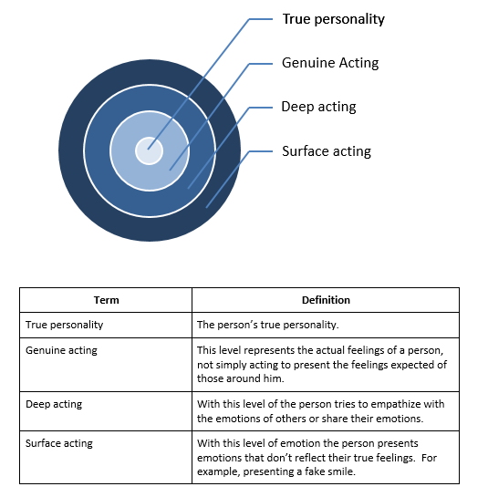
Figure 5.4.1: Emotion Labor
Link to alternative text for this content

Slide 19
Module 5: Communication and Change
Virtual Connections
L.O. 5.5.1: Evaluate the impact of technology on social interaction.
Technology: tools created by science to address and solve the problems of mankind.

Slide 20
Module 5: Communication and Change
Our Social Networking Life
L.O. 5.5.2: Demonstrate the role of perception in social interaction.
Thomas Theorem: the idea that if we think something is real, then it is indeed real to us.

Slide 21
Table 5.5.1: The Pros and Cons of Social Networking Sites
Pros of Social Networking | Cons of Social Networking
Information can be spread quickly. Relationships can be strengthened and make new friends. It has helped create thousands of jobs in the technology industry. Social networking offers an outlet for shy or socially isolated individuals. | Information is not necessarily accurate or private. Heavy users tend to have lower grades. It can increase levels of stress in offline relationships. Users have less face-to-face interaction with others. It can harm employee activity because people spend time online instead of working. Users are more likely to be prone to social isolation in the first place.
Link to alternative text for this content

Slide 23
Accessibility Content: Text Alternatives for Images

Slide 24
Statuses Overview – Text Alternative
Master status is the social position central to your identity, including the status you were born into (ascribed) and the status you earned (achieved).
Ascribed status includes: Race, ethnicity, sex, and age.
Achieved status includes: Education, wealth, talents, and skills.
Return to slide containing original content
United Instructors & Textbook Authors Co-op - SociologicalYOU - ISBN 978-1-64007-406-4 - All Rights Reserved

Slide 25
Role Conflict – Text Alternative
As a student, friend, child, sibling, employee, etc., you likely experience role conflict. For example, trying to maintain a GPA for a scholarship while working 20 hours part-time, finding a summer internship while having to fix the plumbing, and wrapping and taking a package to the Post Office while finding time to exercise can all lead to role conflict.
Return to slide containing original content
United Instructors & Textbook Authors Co-op - SociologicalYOU - ISBN 978-1-64007-406-4 - All Rights Reserved

Slide 26
Role Strain – Text Alternative
You can experience strain within one role (role strain), due to high demands and expectations. For example, as a student, you may be asked to attend an exam review, complete a 10-page paper, and participate in group projects; when all of these demands and expectations pile up, you experience role strain.
Return to slide containing original content
United Instructors & Textbook Authors Co-op - SociologicalYOU - ISBN 978-1-64007-406-4 - All Rights Reserved

Slide 27
Emotion Labor – Text Alternative
Emotion labor occurs at different levels, ranging from true personality, genuine acting, deep acting, to surface acting. These levels can be expressed through a diagram of a bullseye, where true personality is at the center, and surface acting is at the outer most area of the circle; the farther you get away from the center of the bullseye, the farther you move away from your true personality.
True personality: A person’s true personality.
Genuine acting: A person’s actual feelings, not simply acting to present the feelings expected of those around them.
Deep acting: A person’s attempt to empathize with the emotions of others or share their emotions.
Surface acting: A person’s emotional presentation that doesn’t reflect their true feelings (e.g. faking a smile).
Return to slide containing original content
United Instructors & Textbook Authors Co-op - SociologicalYOU - ISBN 978-1-64007-406-4 - All Rights Reserved

Slide 28
The Pros and Cons of Social Networking Sites – Text Alternative
Pros of social networking:
Information can be spread quickly, relationships can be strengthened, individuals can make new friends, it has helped create thousands of jobs in the technology industry, and social networking offers an outlet for shy or socially isolated individuals.
Cons of social networking:
Information is not necessarily accurate or private, heavy users tend to have lower grades, it can increase levels of stress in offline relationships, users have less face-to-face interaction with others, it can harm employee activity because people spend time online instead of working, and users are more likely to be prone to social isolation in the first place.
Return to slide containing original content
United Instructors & Textbook Authors Co-op - SociologicalYOU - ISBN 978-1-64007-406-4 - All Rights Reserved

