Slide 1
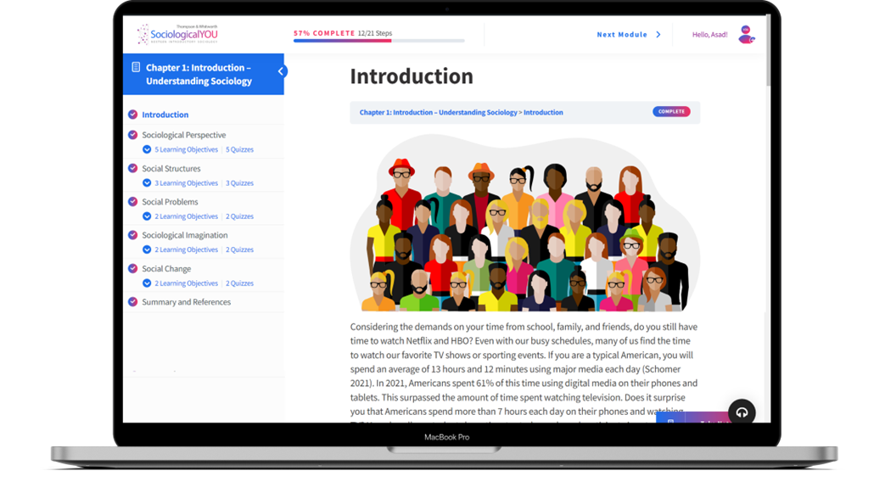

SociologicalYOU
Angela Thompson, Ph.D.
Keith Whitworth, Ph.D.
Introductory Sociology

Slide 2
Chapter 8
Stratification: The Rich Get Richer and the Poor Get Poorer

Slide 3
Modules
Module 1: The Sociological Perspective on Social Class
Module 2: The Inequality of Social Stratification
Module 3: Problems of Stratification
Module 4: The American Dream
Module 5: Stratification and Social Change
This PowerPoint does not cover every key term in Chapter 8.
Please read your textbook to see what is not covered in the PowerPoint.

Slide 4


Points to Ponder
How does socioeconomic status impact our everyday lives?
Why is it important to understand that the wealth gap between the rich and poor is growing wider?
Does everyone have an equal chance of moving up a social class and achieving social mobility?

Slide 5
Module 1: The Sociological Perspective on Social Class
Determining Social Class
L.O. 8.1.1: Discuss how social class is determined and how it impacts the process of individuals and groups interacting within society.
Social Class: a category of people with similar status, culture, and wealth.
Class Consciousness: an awareness of one’s social category within a social hierarchy.
Social Status: an individual’s position or rank within a social system.
Social Stratification: a system in which categories of people are ranked in a hierarchy.
Socioeconomic Status (SES): an individual’s social position based upon education, occupation, income, and place of residence.
Income: money earned on a regular basis through work.

Slide 6
Module 1: The Sociological Perspective on Social Class
Determining Social Class
L.O. 8.1.1: Discuss how social class is determined and how it impacts the process of individuals and groups interacting within society.
Blue-Collar Worker: an individual who engages in manual labor.
Pink-Collar Worker: an individual who works in women dominated jobs with low pay.
White-Collar Worker: an individual who is employed in a salaried professional, managerial, or administrative position.

Slide 7
Module 1: The Sociological Perspective on Social Class
Determining Social Class
L.O. 8.1.1: Discuss how social class is determined and how it impacts the process of individuals and groups interacting within society.
Wealth: the total of all personal assets including property, investments, and income.
Power: the ability to exert control over others and achieve goals with or without the support of society.
Prestige: the level of esteem and respect afforded an individual often associated with one’s occupation or membership in a group or organization.
Occupational Prestige: a consensus of the value of a job or profession.

Slide 8
Module 2: The Inequality of Social Stratification
Systems of Stratification
L.O. 8.2.1: Identify the four social systems of stratification.
Systems of Stratification
    Open System: a social system that encourages and allows for social mobility.
    Closed System: a social system that that does not allow for social mobility.

Slide 9
Module 2: The Inequality of Social Stratification
Systems of Stratification
L.O. 8.2.1: Identify the four social systems of stratification.
Slavery System: a type of a closed stratified system in which slaves and owners exist.
Caste System: a type of closed stratified system in which people are designated to a particular social position based on their parents’ status in the society.
Estate System: a type of closed stratified system in which wealthy land owners and peasants exist.
Class System: a type of open stratified system that allows social mobility.

Slide 10
Table 8.2.1: Four Systems of Social Stratification
Type | Definition | Open or Closed System | Example
Slavery | a closed stratified system in which slaves and owners exist | Closed | Mauritania – although illegal since 1981, there are currently over 40,000 slaves.
Caste | a closed stratified system in which some people are designated at birth to the lowest of classes based upon their parents’ status | Closed | India – the caste system was ruled illegal in 1950, but the Dalits still are discriminated against systemically.
Estate | a closed stratified system in which wealthy landowners and peasants exist | Closed | Primarily existed in the Middle Ages (500-1500 C.E.) and was comprised of wealthy landowners, clergy, and peasants.
Social Class | an open stratified system that allows social mobility | Open | U.S. – Americans can move up and down social classes based upon merit and structural changes in the economy.
Link to alternative text for this content

Slide 11
Module 2: The Inequality of Social Stratification
Systems of Stratification
L.O. 8.2.1: Identify the four social systems of stratification.
Ascribed Status: a position within a social system that is assigned based upon characteristics such as sex, race, or economics.
Achieved Status: a position within a social system that is gained through merit.
Triple Oppression: combined characteristics of being a woman, poor, and a minority.
American Dream: a commonly held belief in the U.S. suggesting that anyone can overcome obstacles and get ahead in life through hard work and determination.

Slide 12
Module 2: The Inequality of Social Stratification
Social Classes
L.O. 8.2.2: Describe each of the social classes in the U.S.
Upper Class: a category of people who maintain the highest status and resources within a society.
Middle Class: the category of people at the center within a social hierarchy.
Lower Class: the lowest category of people within a social hierarchy.
Federal Poverty Line: a governmental standard of measurement indicating the income level at which an individual or family is designated as poor.
Working Poor: individuals who spend more than 27 weeks per year in the paid labor force and live below the poverty line.

Slide 13
Module 3: Problems of Stratification
The Nature of Poverty
L.O. 8.3.1: Examine the types of poverty and its cyclical nature.
Poverty Rate: the percentage of people who are considered poor.
Absolute Poverty: a threshold in which an individual or family does not have enough resources to meet their basic survival needs.
Relative Poverty: a subjective level at which an individual or family experiences a deprived lifestyle.

Slide 14

Module 3: Problems of Stratification
Global Poverty
L.O. 8.3.2: Compare and contrast the modernization and dependency theories in relation to global poverty.
Modernization Theory: a macro theory indicating the process by which nations progress through stages of development.
Dependency Theory: a macro theory indicating the stratified world economic system keeps peripheral nations dependent on core nations.

Slide 15
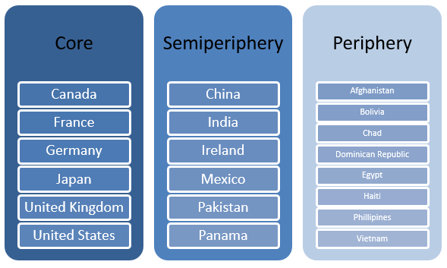
Figure 8.3.2: World-System Analysis at the beginning of the 21st Century
Link to alternative text for this content

Slide 16
Module 3: Problems of Stratification
Inequality in Society
L.O. 8.3.3 Describe the issues associated with economic, race, gender and educational stratification in society.
Types of Social Inequality
Economic (Class) Inequality
    Wealth Gap: the uneven distribution of financial assets and resources in a society that result from the concentration of money in the hands of a small segment of the population.
Racial Inequality
Gender Inequality
Educational Inequality

Slide 17
Module 4: The American Dream
Private Trouble and Public Issue of Stratification
L.O. 8.4.1: Apply the sociological imagination to social mobility and an individual’s life chances.
Social Mobility: an individual or groups movement up or down the system of stratification in a society.
Life Chances: the opportunities and resources a person has at their disposal to improve their quality of life.
Cultural Capital: the information, knowledge and ideas that a person uses to support their social mobility.
Social Capital: the network of links that develop between people, which may result in personal, social and professional advantage.
Digital Divide: the access to and ability to use technology like computers and the internet.

Slide 18
Module 4: The American Dream
The Ups and Downs of Stratification
L.O. 8.4.2: Examine the various forms of social mobility in a system of stratification.
Vertical Mobility: movement up or down the system of stratification.
Horizontal Mobility: movement within a layer of the system of stratification.
Intergenerational Mobility: an individual’s change in social status that results from mobility on a generational level.
Intragenerational Mobility: an individual’s change in status during a lifetime.
Structural Mobility: changes in the social position of a group that result from shifts in the larger society.

Slide 19
Module 4: The American Dream
The Feminization of Poverty
L.O. 8.4.3: Analyze the experience of women in the system of stratification.
Feminization of Poverty: the disproportionate number of women amongst the world’s poor.

Slide 20
Module 5: Stratification and Social Change
Stratification and Social Change
L.O. 8.5.1: Analyze social policies designed to create change in the system of stratification.
Global Inequality: the stratification that exists between people living in different nations.
Efforts to Address Global Inequality
    Affordable Care Act (Obamacare)
    United Nations International Children’s Emergency Fund (UNICEF)
    United Nations International Children’s World Food Program
    United Nations High Commissioner for Refugees

Slide 22
Accessibility Content: Text Alternatives for Images

Slide 23
Four Social Systems of Social Stratification – Text Alternative
Slavery: Closed stratified system in which slaves and owners exist (e.g. Mauritania).
Caste: Closed stratified system in which some people are designated at birth to the lowest of classes based upon their parents’ status (e.g. India – the caste system was ruled illegal in 1950, but the Dalits still are discriminated against systematically).
Estate: Closed stratified system in which wealthy landowners and peasants exist (e.g. Primarily existed in the Middle ages, 500-1500 C.E., and was comprised of wealthy landowners, clergy, and peasants).
Social Class: Open stratified system that allows social mobility (e.g. U.S. – Americans can move up and down social classes based upon merit and structural changes in the economy).
Return to slide containing original content
United Instructors & Textbook Authors Co-op - SociologicalYOU - ISBN 978-1-64007-406-4 - All Rights Reserved

Slide 24
World-System Analysis at the beginning of the 21st Century – Text Alternative
Core: Canada, France, Germany, Japan, United Kingdom, and United States.
Semi-periphery: China, India, Ireland, Mexico, Pakistan, and Panama.
Periphery: Afghanistan, Bolivia, Chad, Dominican Republic, Egypt, Haiti, Philippines, and Vietnam.
Return to slide containing original content
United Instructors & Textbook Authors Co-op - SociologicalYOU - ISBN 978-1-64007-406-4 - All Rights Reserved

